Slide 1



Generative models to assist sampling:
A tentative tutorial
November 27-December 1st 2023
IAP, Paris / Flatiron institute, New York
Marylou Gabrié
CMAP, École Polytechnique

Slide 2
Deep generative models based on transport
Deep latent generative models
Invertible map/transport based models:
(Normalizing flows (discrete time), Neural ODEs, Score-based diffusion models, etc.)
Training
  From data samples assumed to be i.i.d
    Maximum likelihood: minimize
    Score based objectives
“push-forward” distribution
New dog picture for each new base variable!
Song et al. ICLR 2021
[“Normalizing flows” Tabak & V.-E. Commun. Math. Sci. 2010, Dinh et al ICLR 2017, Papamakarios et al. JMLR 2021, “Score based diffusion models” Song et al. ICLR 2021, “Stochastic interpolants [..]” Albergo et al. arxiv:2303.08797 etc.]

Slide 3
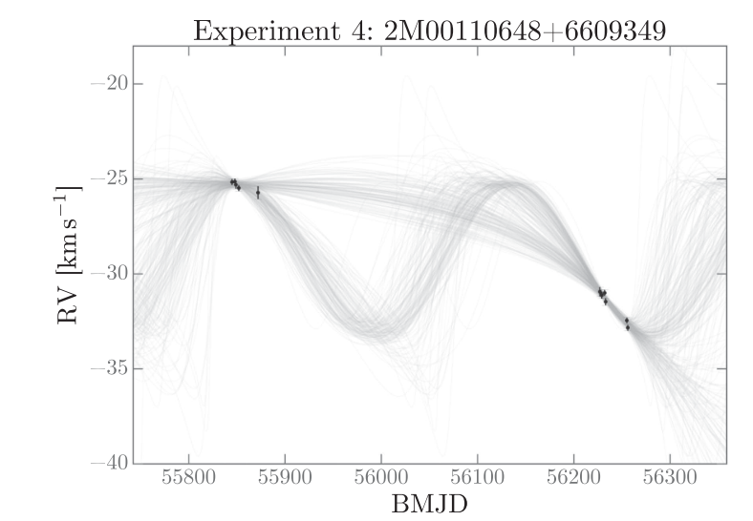
High-dimensional inference
A distribution of interest known up to normalization (posterior/Boltzmann)
Direct inference is intractable , costs for
Monte Carlo methods rely on samples: for
Sampling itself can be challenging (dimensionality, geometry, multimodality)
This talk: How we use deep generative models to speed up sampling?
ex: molecular configurations
ex: Bayesian model parameters
ex: Star-exoplanet system
Alanine-dipeptide
Jiang et al J. Phys. Chem. B 2019
Price-Whelan et al. The Astrophysical Journal 2017

Slide 4
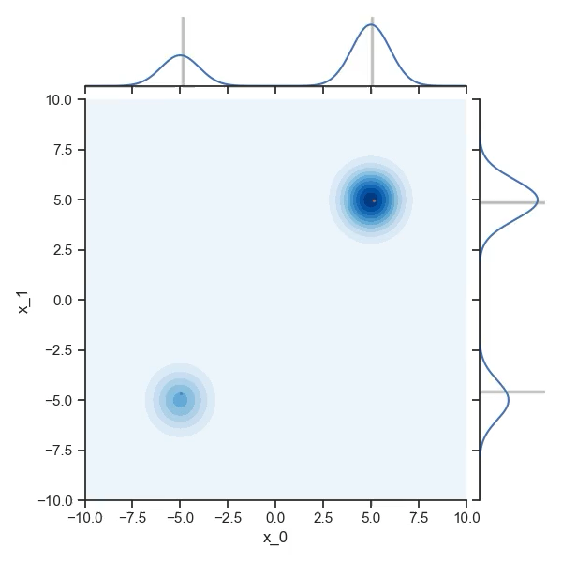
Consider simple samplers
Importance sampling
rely on a tractable proposal
Markov Chain Monte Carlo:
e.g. Metropolis Hastings
rely on local proposal

Slide 5
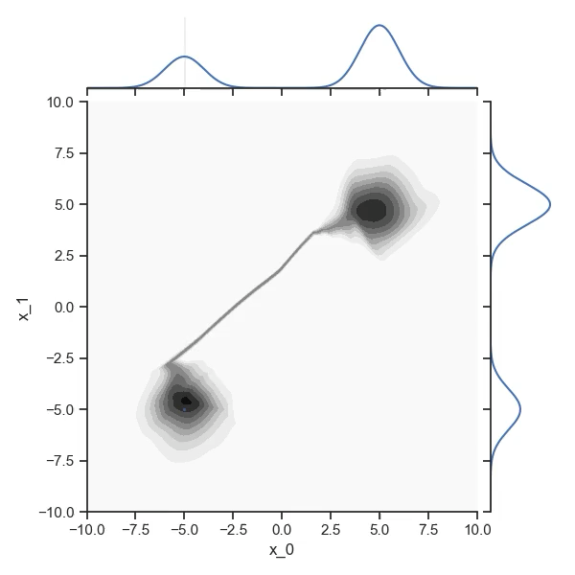
Suppose you can train a model , what do you gain?
Markov Chain Monte Carlo:
e.g. Metropolis Hastings
rely on global proposal!
Importance sampling
rely on adapated tractable proposal!

Slide 6


Suppose you can train a model ,
what do you gain?
A lot!

Slide 7
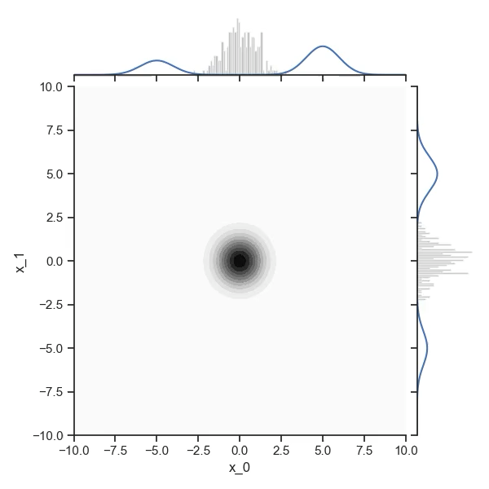
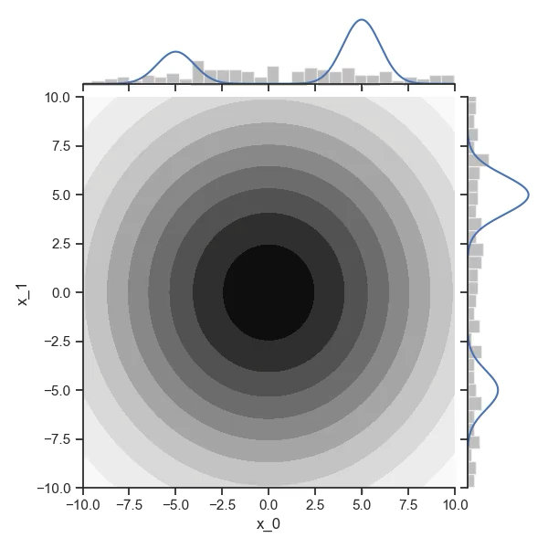
First idea: variational inference “on steroids”:
Caution: prone to mode-collapse
A data-free learning objective: the (reverse) Kullback-Leibler divergence
Weiss, P. (1907). L’hypothèse du champ moléculaire et la propriété ferromagnétique.
Wainwright, M. J., & Jordan, M. I. (2008). Graphical Models, Exponential Families, and Variational Inference.
Rezende & Mohamed, (2015). Variational inference with normalizing flows
Wu et al. (2019). Solving Statistical Mechanics Using Variational Autoregressive Networks.
Albergo et al (2019). Flow-based generative models for Markov chain Monte Carlo in lattice field theory.
Li, Shuo-Hui, and Lei Wang. “Neural Network Renormalization Group.” PRL 2018
Compress references

Slide 8
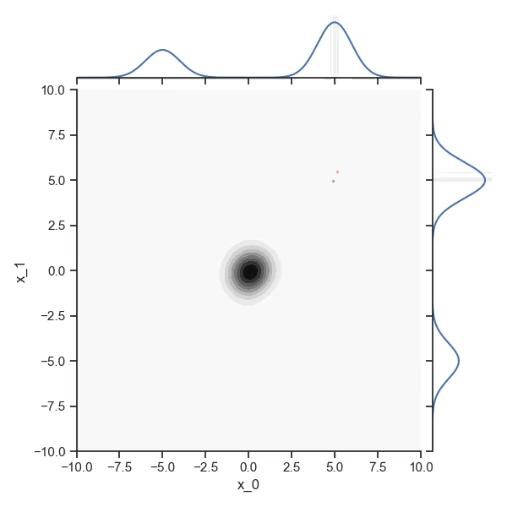
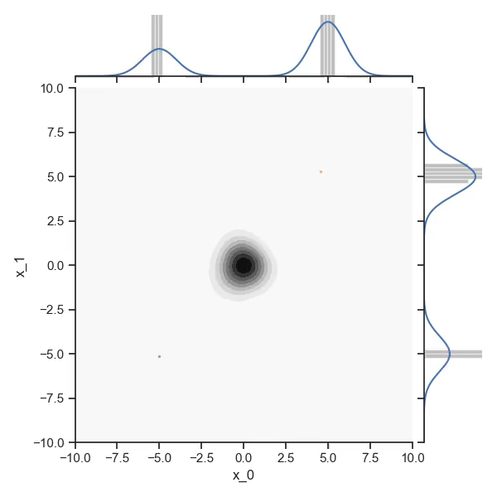
Second idea: Adaptive Markov Chain Monte Carlo: simultaneous convergence of training & sampling
With Eric Vanden-Eijnden (Courant NYU) & Grant Rotskoff (Stanford)
Maximum likelihood objective (a.k.a forward KL)
Use an auxillary simple sampler to create data
Train
Add non-local steps relying on flow proposals
Repeat and converge
Global-Local algorithm!
No free lunch!
[Parno & Marzouk 2018 SIAM Journal of Uncertainty; Naesseth et al. Neurips 2020; MG, Rotskoff, Vanden-Eijnden PNAS 2022]

Slide 9
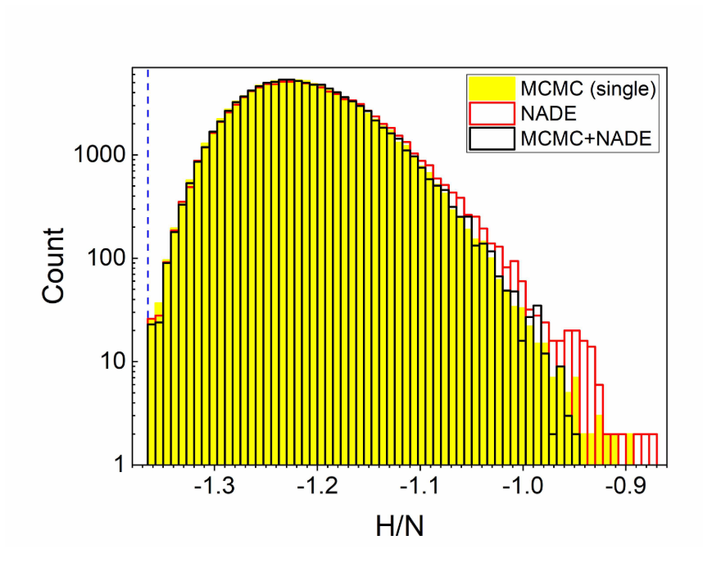
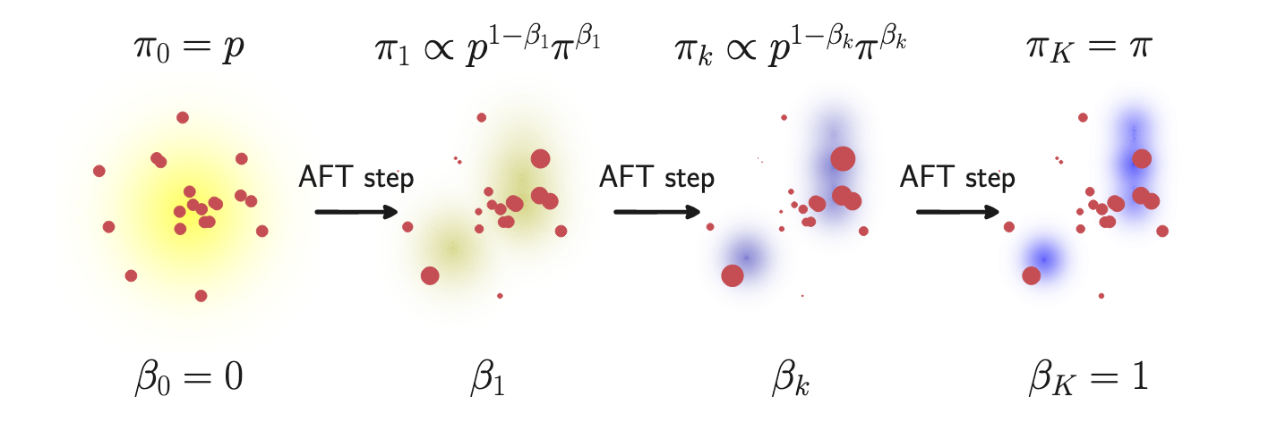
Third idea: Joining forces with annealing/SMC
SMC + PMC -> and the difference between them
Could group the two stat mech paper + add pocoMC with sequential Monte carlo
Annealing to create progressively dataset of training
﻿From high-temperature repeat:
  Use in MCMC to sample
  Use as data to train
(Continuously Repeated) Annealed Flow Transport
  Add flow transport maps within steps of sequencial Monte Carlo (SMC)
Preconditioned SMC (PMC)
S. Pilati PRE 2020
2d – Edwards Anderson
Credit M. Arbel
Boosting Monte Carlo simulations of spin glasses using autoregressive neural networks- B. McNaughton et al PRE 2020
(Continuously Repeated) Annealed Flow Transport Monte Carlo. Arbel, Matthews et al (2021 & 2022)
Karamanis et al . ‘Accelerating Astronomical and Cosmological Inference with Preconditioned Monte Carlo. (2022)

Slide 10


Variational inference
Adaptive MCMCs
Annealed training/
Sequential Monte Carlo
Suppose you can train a model ,
what do you gain?
A lot!
Examples

Slide 11
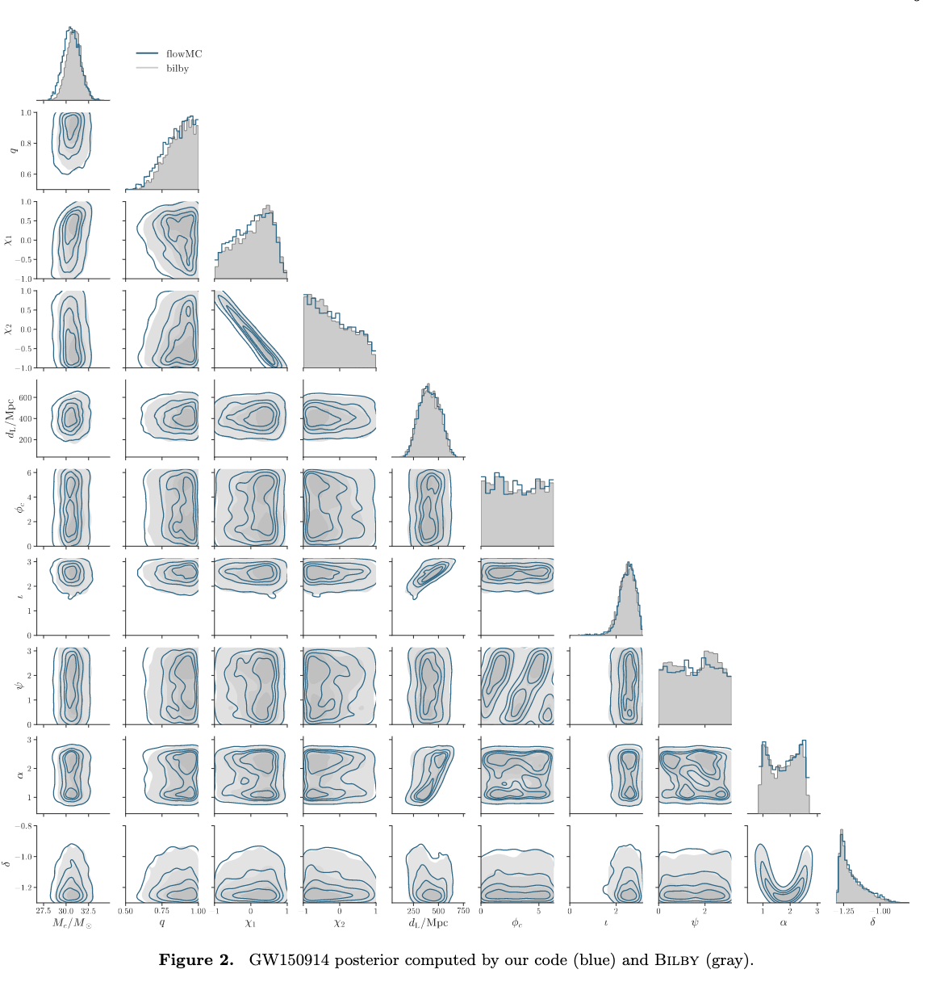
Example 1/2: Bayesian inference of Gravitational Waves parameters
Kaze W. K. Wong (CCA)
Competitive for a real-time application of
estimating parameters of gravitational wave
Fast gravitational wave parameter estimation without compromises - Kaze W. K. Wong et al. arxiv.org/2302.05333

Slide 12
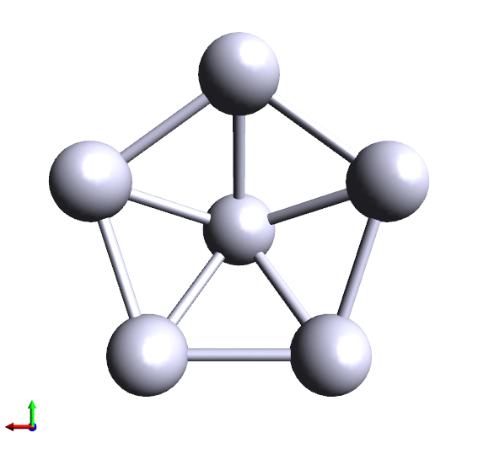
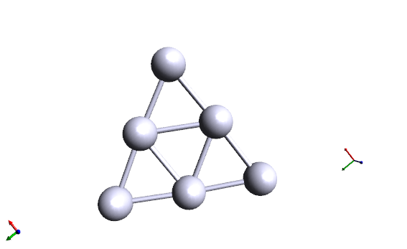
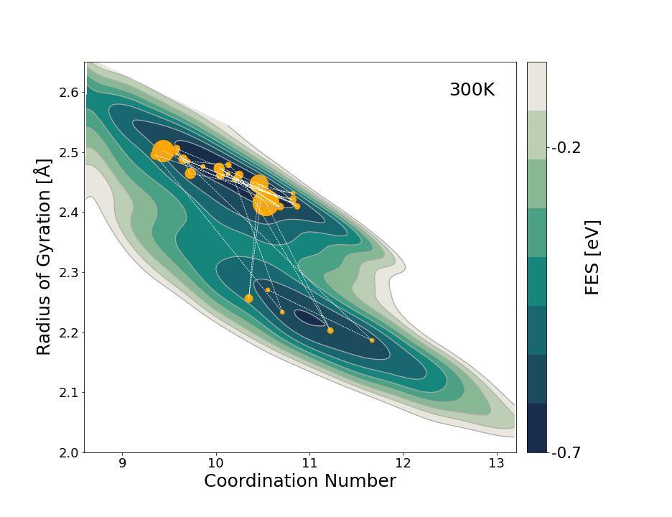
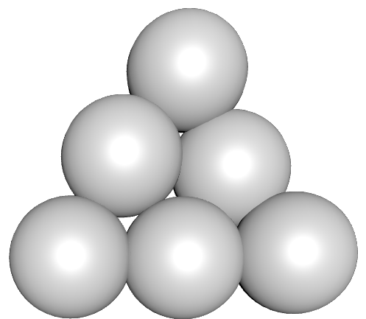
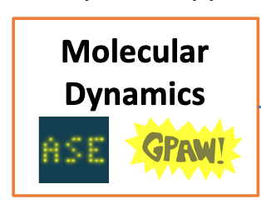
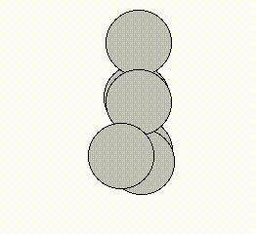
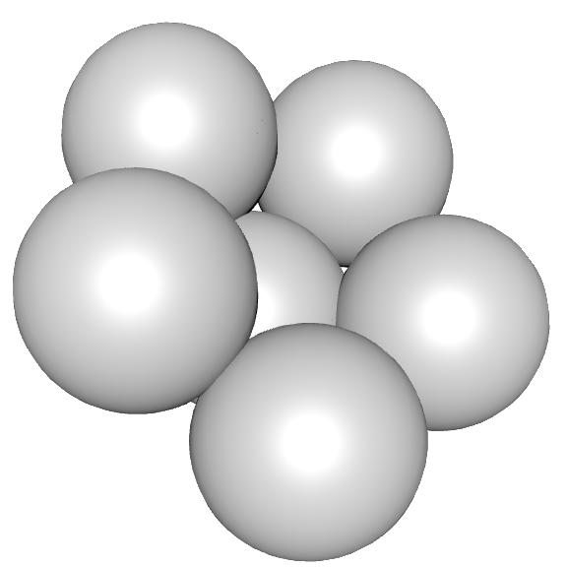
Example 2/2: Sampling metastable silver clusters
With Ana Molina Tarboda, Olga Lopez-Acevedo (Universidad de Antioquia), Pilar Cossio (Flatiron Institute)
Target density given by Density Functional Theory: 2 metastable isomers
Local sampler: Molecular Dynamics
Adaptive MCMC jumping between isomers
  Using here a mixture of flows
2 dimension projection of
the free energy surface
[in preparation]

Slide 13
Variational inference
Adaptive MCMCs
Annealed training/
Sequential Monte Carlo
Suppose you can train a model ,
what do you gain?
Always possible?
A lot!

Slide 14
Is the model good enough to be useful? Is the sampling converged?
Key observables:
  Neural Importance Sampling
    Participation ratio
  Independent Metropolis Hastings:
    Acceptance rate of the proposal
What is going to make the method fail? Discrepancies
  Posteriors/Targets too intricate to be represented
  Dimensionality …
Can we be less ambitious but still take advantage of the generative models?

Slide 15
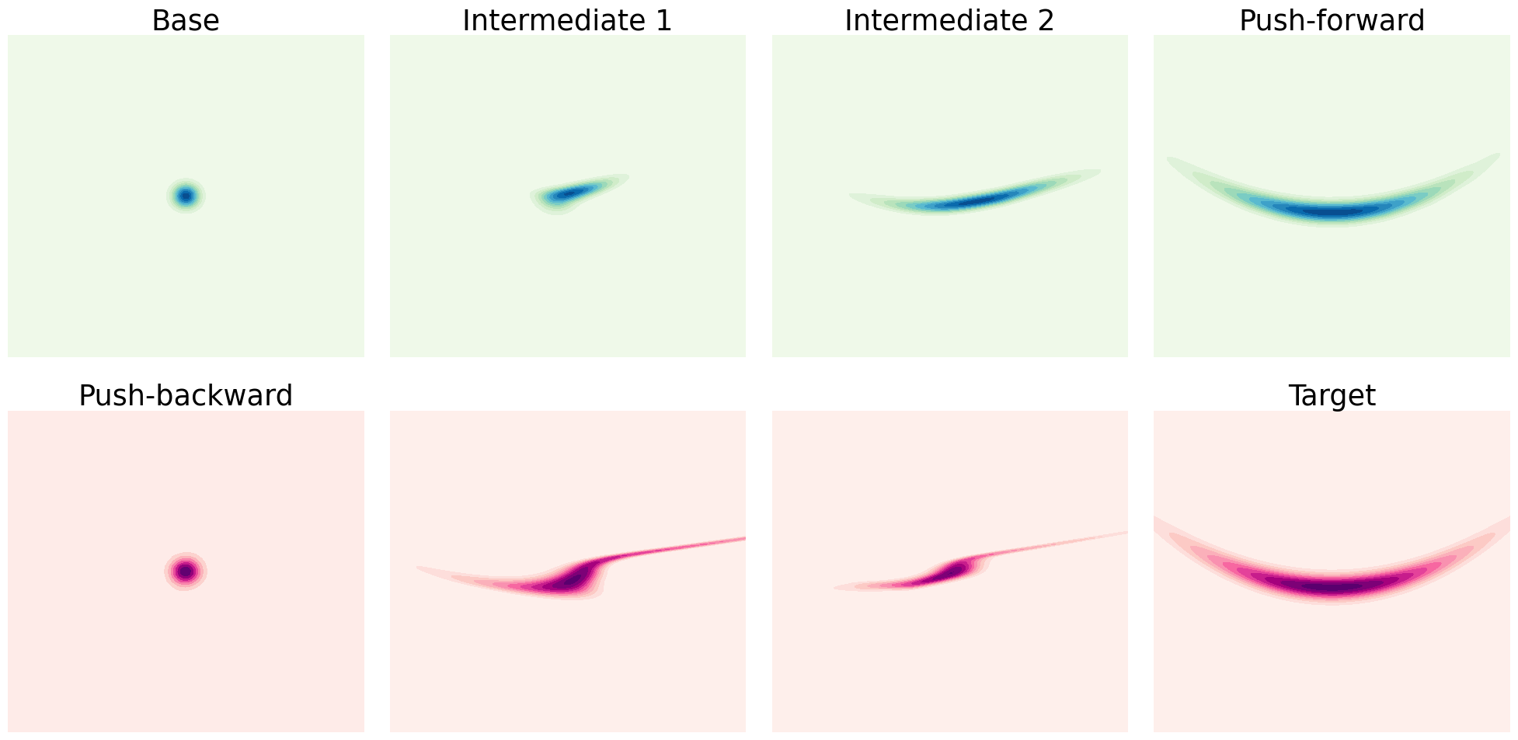
Pre-conditioning local samplers with flows
“Neutra-MCMC”: Run a gradient-based local sampler (HMC, MALA) in the latent space
Why? Local samplers are more robust in high-dimension, and are greatly helped by preconditionning
[Li & Wang PRL 2018, Wu et al. PRL 2019, Noé et al. Science 2019, Hoffman et al arXiv:1903.03704]

Slide 16
Flow proposals vs latent local jumps 1/2
[Grenioux, Durmus, Moulines & MG, ICML 2023]
With Louis Grenioux & Christoph Schönle (École Polytechnique)
Preconditioned gradient-based sampling typically more robust to poor flows
But learned transport maps do not eras multimodality
NeutraMALA
FlowMC
[Cornish et al. ICML 2020. Salmona et al. Neurips 2022.]

Slide 17
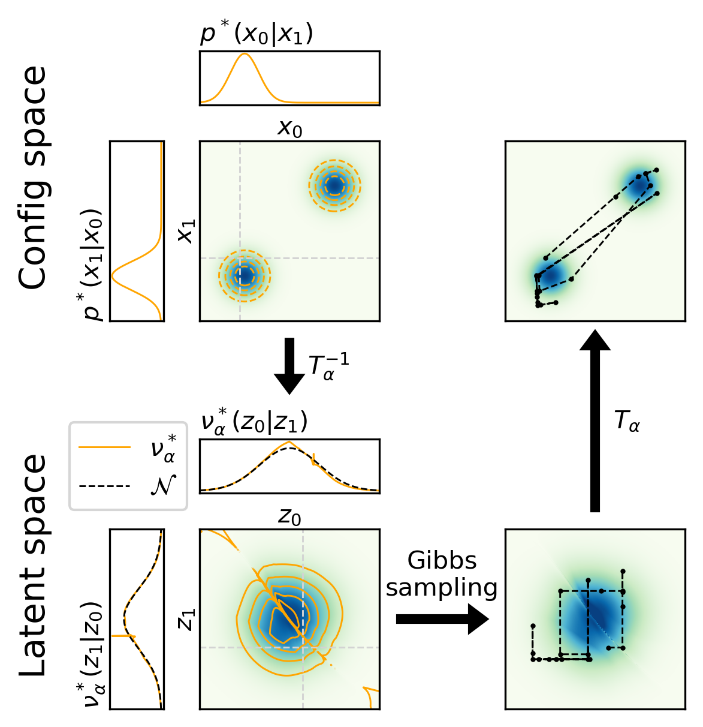
Flow proposals vs latent local partial jumps 2/2
[Schönle & MG, NeurIPS Workshop 2023]
With Louis Grenioux & Christoph Schönle (École Polytechnique)
Partial updates in latent space allow mixing while improving acceptance: GflowMC
Metropolis-within-Gibbs
update clusters of
latent variables

Slide 18
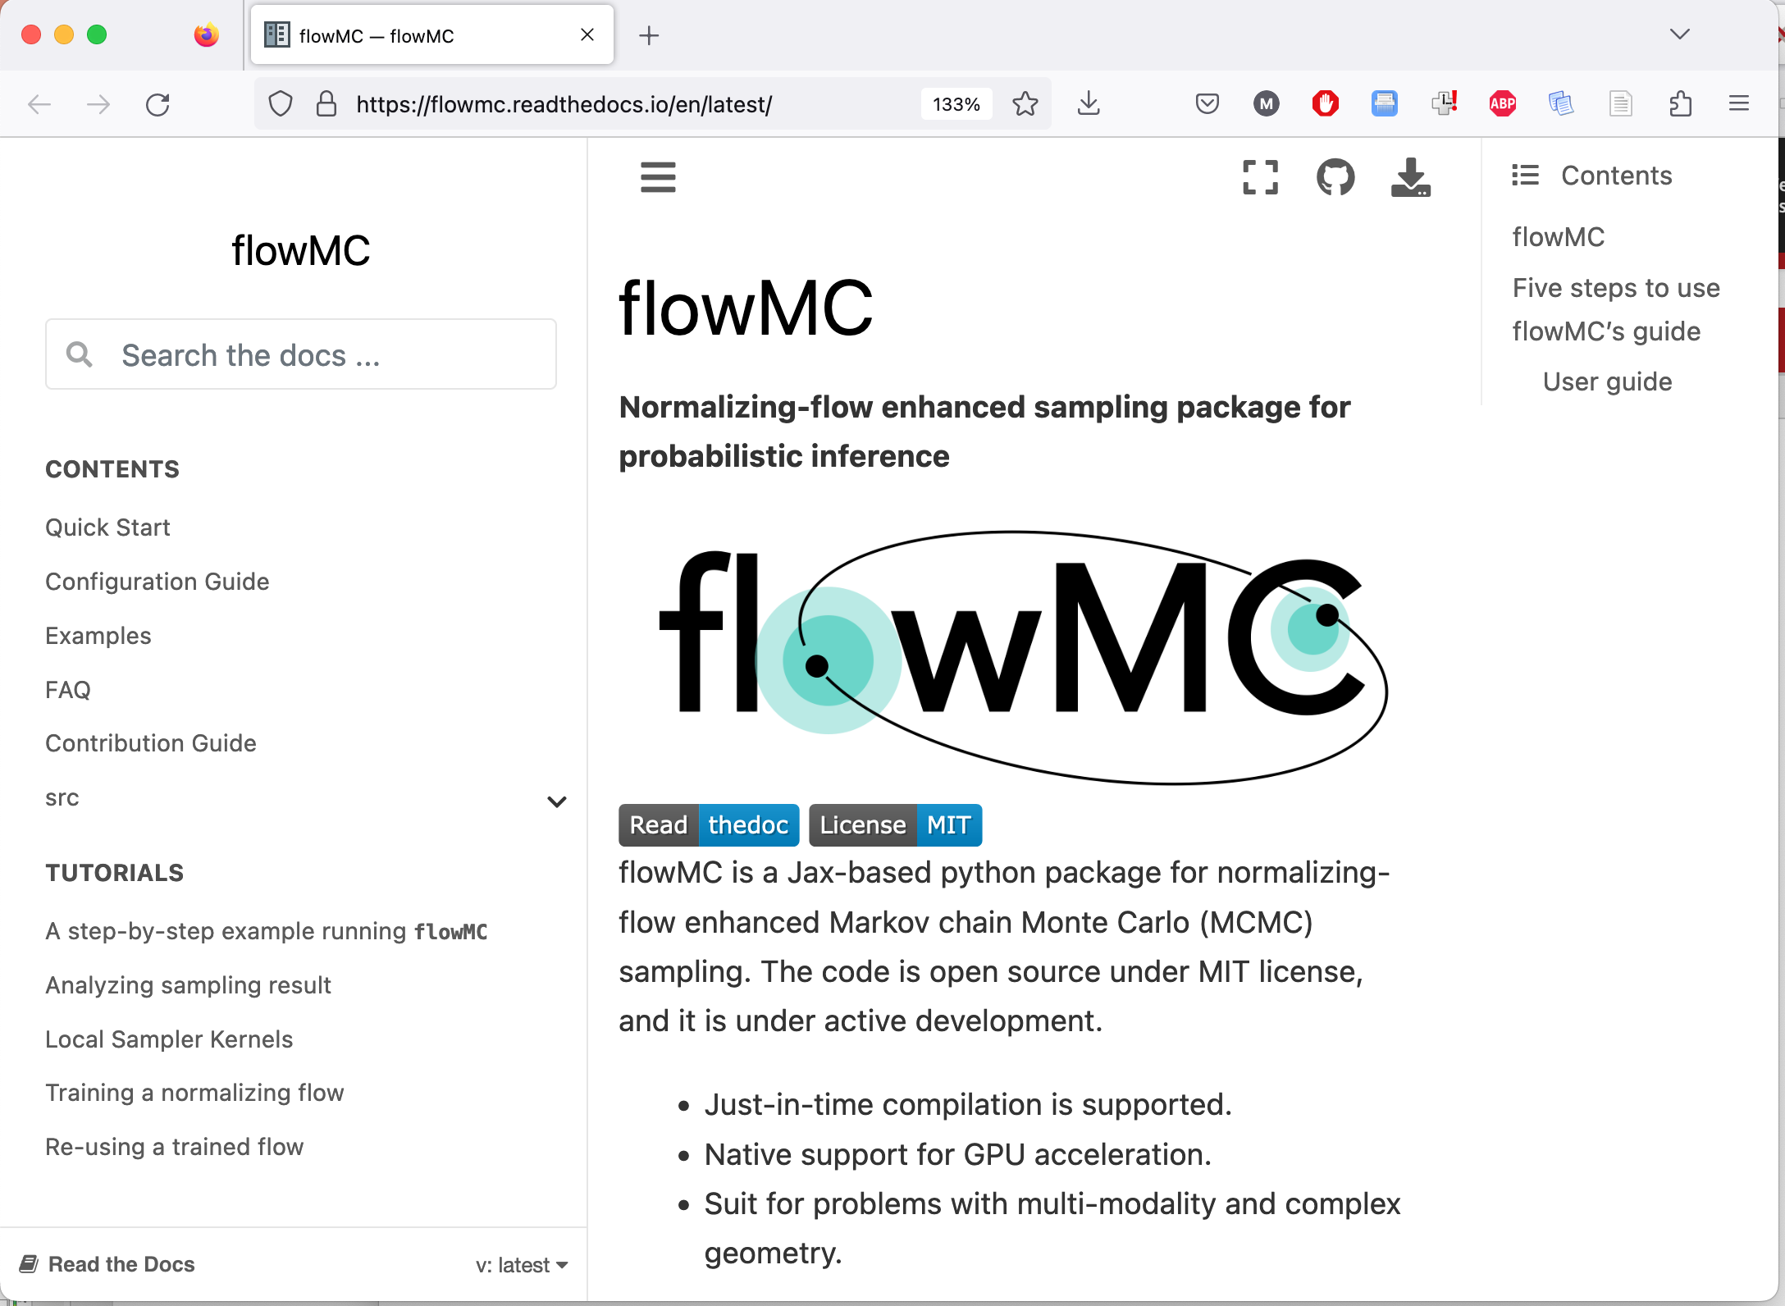
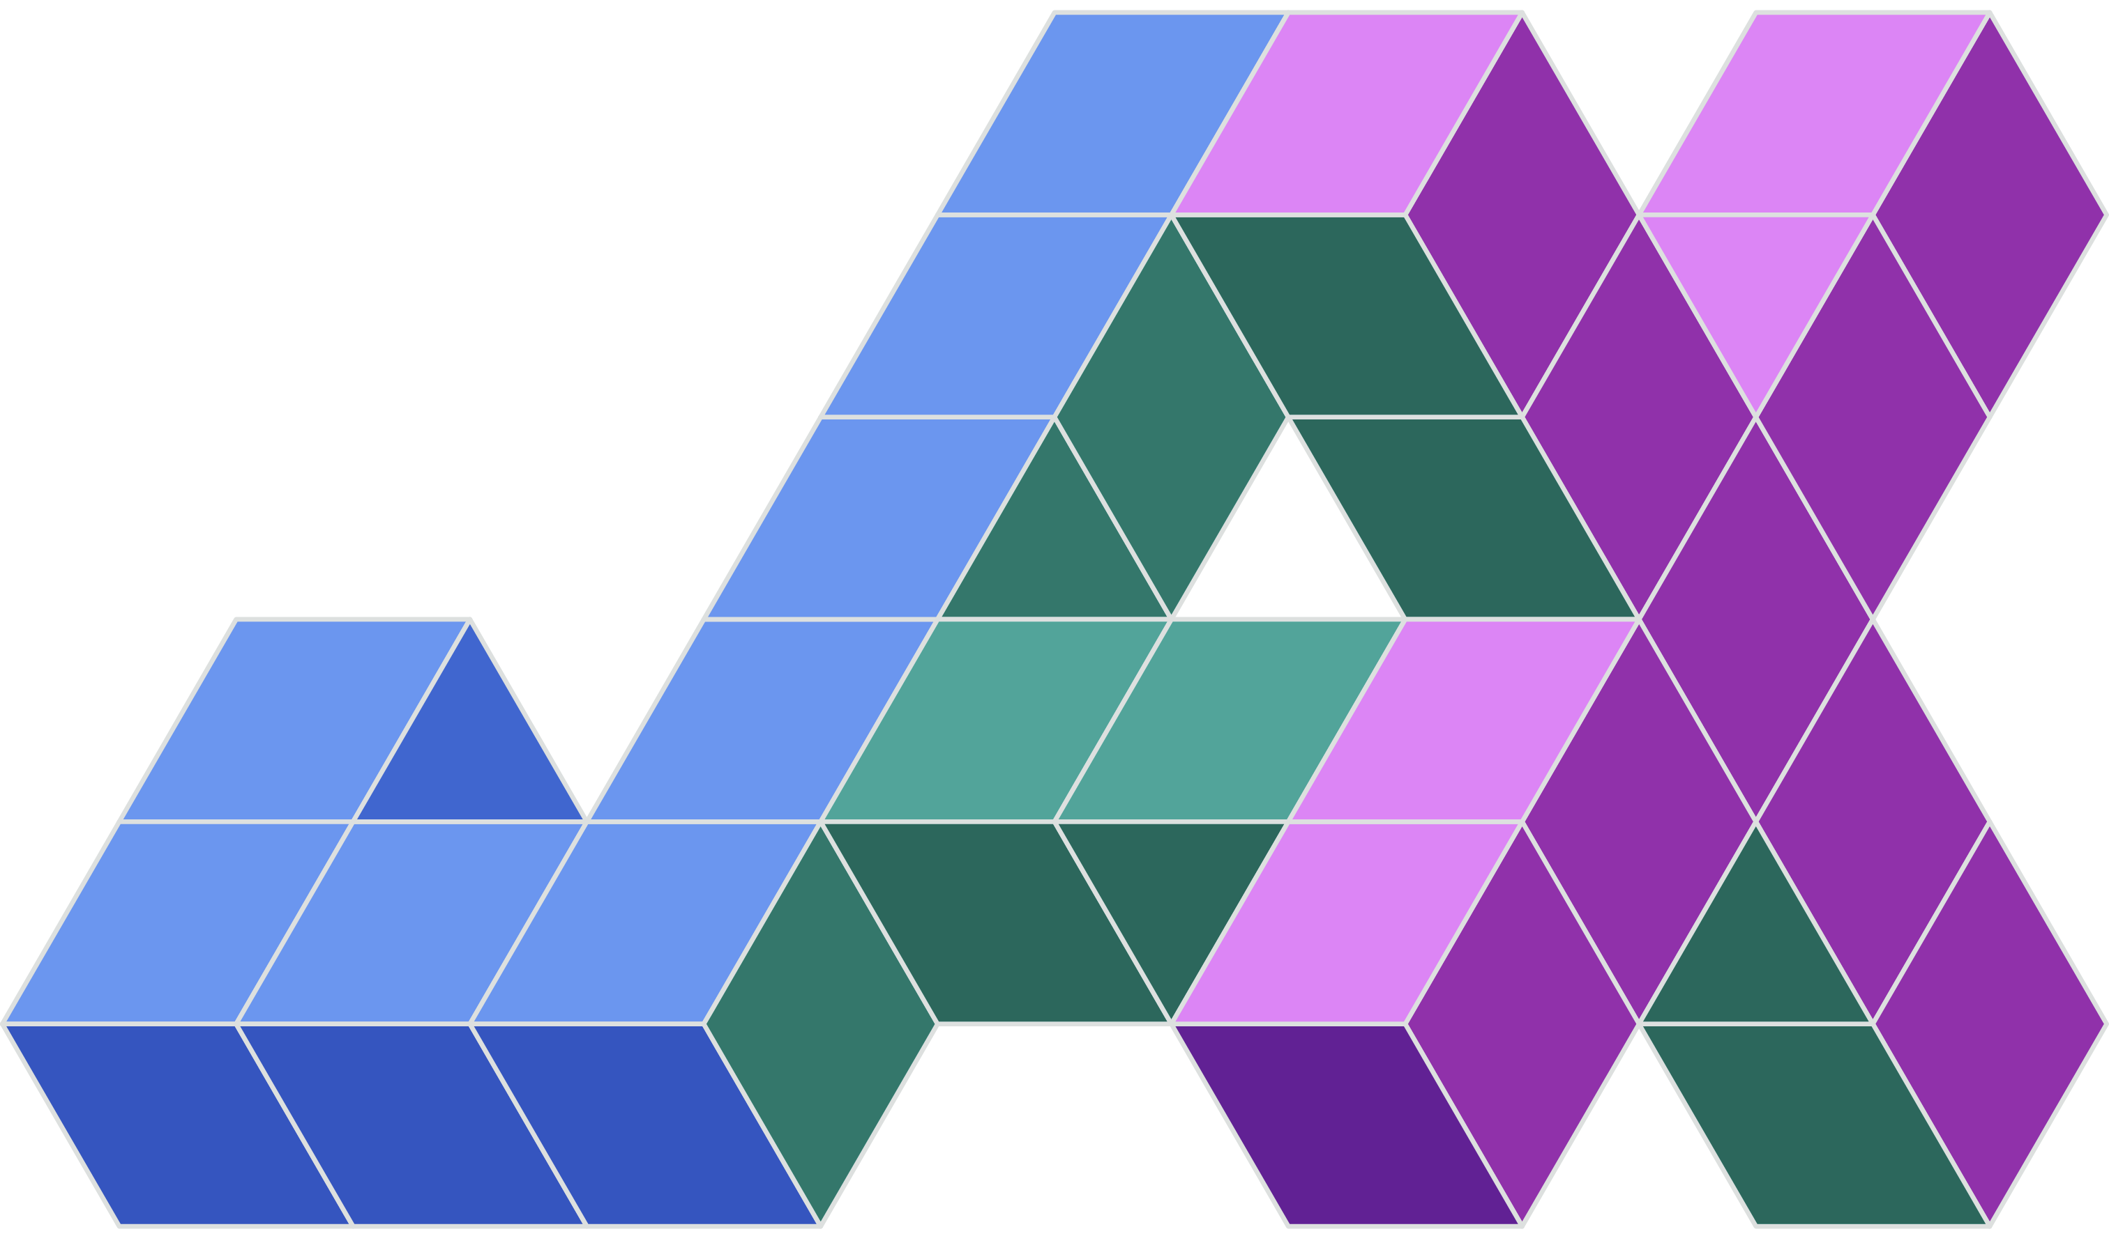
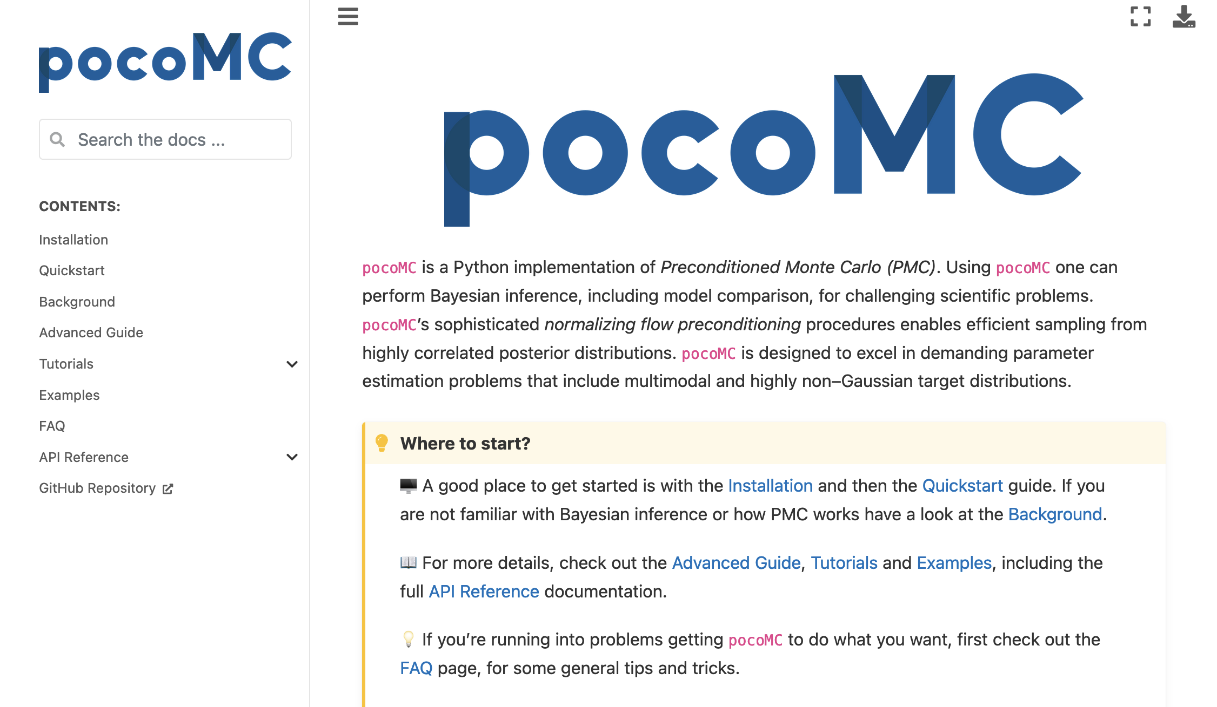

2 Python packages I am aware off
flowMC
Wong et al. 2022
(adaptive MCMC)
pocoMC
Karamanis et al. 2022
(preconditioned SMC)
> pip install flowmc
> pip install pocomc

Slide 19
Perspectives & Conclusions
Progess in generative modelling suggests a road to machine learning enhance samplers.
Reaching the level of training accuracy required is not trivial for complex systems.
Adaptations are possible for continuous time generative models, but are costly.
There is no free lunch in finding the modes.
These methods appear to be well-suited for Bayesian inference problems in moderate dimension (~100)!
Notes:
gener

Slide 20
Thank you
Collaborators:
Grant Rotskoff (Stanford), Éric Vanden-Eijnden (Courant Institute, NYU)
Louis Grenioux, Christoph Schönle, Alain Durmus & Eric Moulines (École Polytechnique)
Pilar Cossio (Flatiron, CCM), Olga Lopez Acevedo & Ana Molina Taborda (Universidad de Antioquia)
Kaze Wong & Dan Foreman-Mackey (Flatiron, CCA)

Slide 21
Based on
M. Gabrié, G. M. Rotskof, and E. Vanden-Eijnden, ‘Efﬁcient Bayesian Sampling Using Normalizing Flows to Assist Markov Chain Monte Carlo Methods’, ICML workshop 2021
M. Gabrié, G. M. Rotskoff, and E. Vanden-Eijnden, ‘Adaptive Monte Carlo augmented with normalizing flows’, PNAS 2022
J. A. Brofos, M. Gabrié, M. A. Brubaker, and R. R. Lederman, ‘Adaptation of the Independent Metropolis-Hastings Sampler with Normalizing Flow Proposals’. AISTAT 2022
S. Samsonov, E. Lagutin, M. Gabrié, A. Durmus, A. Naumov, and E. Moulines, ‘Local-Global MCMC kernels: the best of both worlds’, in Neural Information Processing Systems, 2022.
K. W. K. Wong, M. Gabrié, and D. Foreman-Mackey, ‘flowMC: Normalizing-flow enhanced sampling package for probabilistic inference in Jax’. Accepted at Journal of Open Science Software 2023
L. Grenioux, A. Durmus, É. Moulines, and M. Gabrié, ‘On Sampling with Approximate Transport Maps’. ICML 2023
L. Grenioux, É. Moulines, and M. Gabrié, ‘Balanced Training of Energy Based Models’, SPIGM Workshop, ICML 2023
C. Schönle and M. Gabrié, ‘Optimizing Markov Chain Monte Carlo Convergence with Normalizing Flows and Gibbs Sampling’. AI for Science Workshop, NeurIPS 2023

Slide 22
One key idea is physics informed learning: for instance system tailored base measure
Φ⁴ model: Retain local couplings of the action
coupling term
local potential
Base samples
Gaussian
white noise
After training
[MG, Rotskoff & Vanden-Eijnden – PNAS 2022 ]
Cf Grant’s talk

Slide 23
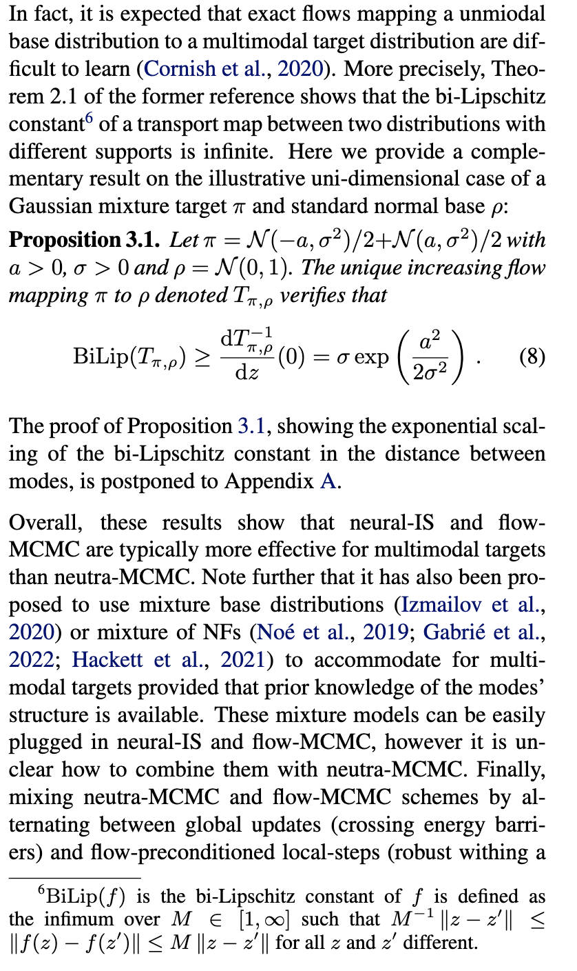
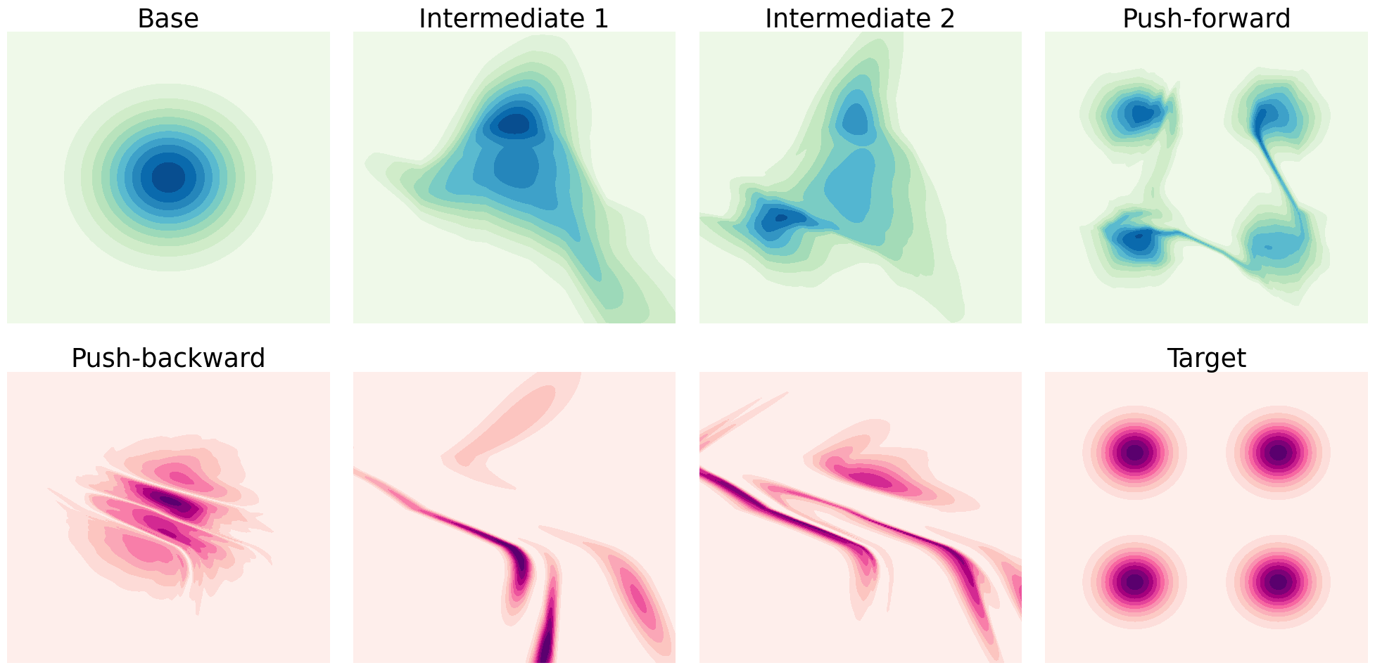
Yet learned transport does not erase mutlimodality
ADD THE MATH OF THE BiLipchitz constants?
Transporting a unimodal base to a multimodal target requires learning a very steep/almost flat transformation
Cornish et al. ICML 2020. Relaxing Bijectivity Constraints with Continuously Indexed Normalising Flows
Salmona et al. Neurips 2022. Can Push-forward Generative Models Fit Multimodal Distributions?

Slide 24
Insights from emprical study for
[Grenioux, Durmus, Moulines & MG, ICML 2023]

Slide 25
Second Idea: Adaptive Markov Chain Monte Carlo: simultaneous convergence of training & sampling
Adaptive MCMCs
Algorithm: Metropolis-Hastings with non-local generative model proposal
  Initialize:
Loop:
Loop over parallel chains:
      Draw from generative model
      Accept-reject
      Local resampling
    Update NF parameters
Local + Mode jumping:
[Haario at al. Bernoulli 2001, Jasra et al Statistics and Computing, 2007, Andrieu et al. Bernoulli 2011, Sejdinovic et al ICML 2014 …]
Metropolis-Hastings with NF
MCMC steps
converging
to the target
Improve surrogate
as you go
Maximum likelihood GD
  [Tjelmeland & Hegstad Scandinavian J. of Statistics 2001, Sminchisescu & Welling AISTAT 2017, Pompe et al. Ann. Stat 2020, Sbailò et al. J. Chem. Phys. 2021, Tawn, Moores & Roberts 2021 …]
[Parno & Marzouk 2018 SIAM Journal of Uncertainty; Naesseth et al. Neurips 2020; MG, Rotskoff, Vanden-Eijnden PNAS 2022]

Slide 26
Ergodicity theory of adaptive MCMC
Theory for independent Metopolis-Hastings sampler:
  Independent proposal:
  Metropolis-Hastings Markov kernel:
The sequence of Markov kernels exhibits diminishing adaptation if
  in probability.
  e.g.: probability to adapt goes to 0, or converging sequence of parameters
The sequence of Markov kernels exhibits containement if:
  For any , there exists such that
Theorems: (Andrieu & Moulines 2006, Roberts & Rosenthal 2007):
  If the sequence of Markov kernels exhibits diminishing adaptation and containment, the chain is ergodic for the distribution .
Assumptions:
[Andrieu & Moulines 2006, Roberts & Rosenthal 2007, Brofos, Gabrié, Lederman & Brubacker 2022 ]

