Slide 1
Less is enough:
extending ΛCDM with representation learning
Davide Piras (and many others)

Slide 2
But first… let me apologise
Notes:
Present you and work. Mention collaborators. Mention that you are open to questions, and that data science includes ML, etc.

Slide 3
But first… let me apologise
Less is enough:
extending ΛCDM with representation learning
Title was not convincing
Notes:
Present you and work. Mention collaborators. Mention that you are open to questions, and that data science includes ML, etc.

Slide 4
But first… let me apologise
Less is enough:
extending ΛCDM with representation learning
Title was not convincing
Notes:
Present you and work. Mention collaborators. Mention that you are open to questions, and that data science includes ML, etc.

Slide 5
But first… let me apologise
parameters
Less is enough:
extending ΛCDM with representation learning
Title was not convincing
Notes:
Present you and work. Mention collaborators. Mention that you are open to questions, and that data science includes ML, etc.

Slide 6
But first… let me apologise
parameters
Less is enough:
extending ΛCDM with representation learning
Title was not convincing
So I did what any AI researcher would do…
Notes:
Present you and work. Mention collaborators. Mention that you are open to questions, and that data science includes ML, etc.

Slide 7
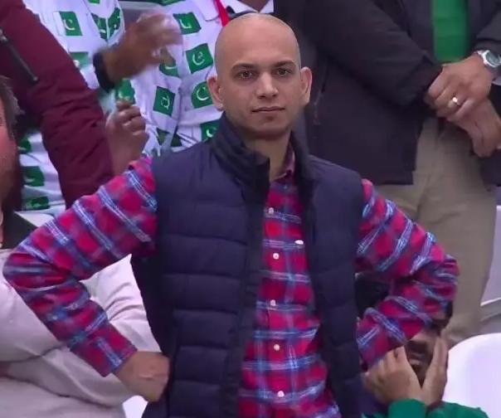
But first… let me apologise
parameters
Less is enough:
extending ΛCDM with representation learning
Title was not convincing
So I did what any AI researcher would do…
… I asked ChatGPT!
Enriching ΛCDM:
extending cosmological models with representation learning
Notes:
Present you and work. Mention collaborators. Mention that you are open to questions, and that data science includes ML, etc.

Slide 8
Less is enough:
extending ΛCDM with representation learning
1
Notes:
Present yourself. You are going to talk about generative methods in Cosmology, as the title suggests. Mention other people that work with you.

Slide 9
Less is enough:
extending ΛCDM with representation learning
1
Notes:
Present yourself. You are going to talk about generative methods in Cosmology, as the title suggests. Mention other people that work with you.

Slide 10
ΛCDM extensions
ΛCDM is good
2
Notes:
Present yourself. You are going to talk about generative methods in Cosmology, as the title suggests. Mention other people that work with you.

Slide 11
ΛCDM extensions
ΛCDM is good
Λ : cosmological constant
CDM: cold dark matter
[insert standard cosmological image here]
2
Notes:
Present yourself. You are going to talk about generative methods in Cosmology, as the title suggests. Mention other people that work with you.

Slide 12
ΛCDM extensions
ΛCDM is good… but not the entire story
2
Notes:
Present yourself. You are going to talk about generative methods in Cosmology, as the title suggests. Mention other people that work with you.

Slide 13
ΛCDM extensions
ΛCDM is good… but not the entire story
Tensions (H₀, S₈)
2
Notes:
Present yourself. You are going to talk about generative methods in Cosmology, as the title suggests. Mention other people that work with you.

Slide 14
ΛCDM extensions
ΛCDM is good… but not the entire story
Tensions (H₀, S₈)
What is dark matter?
2
Notes:
Present yourself. You are going to talk about generative methods in Cosmology, as the title suggests. Mention other people that work with you.

Slide 15
ΛCDM extensions
ΛCDM is good… but not the entire story
Tensions (H₀, S₈)
What is dark matter?
And dark energy?
2
Notes:
Present yourself. You are going to talk about generative methods in Cosmology, as the title suggests. Mention other people that work with you.

Slide 16
ΛCDM extensions
ΛCDM is good… but not the entire story
Tensions (H₀, S₈)
What is dark matter?
And dark energy?
…
2
Notes:
Present yourself. You are going to talk about generative methods in Cosmology, as the title suggests. Mention other people that work with you.

Slide 17
ΛCDM extensions
ΛCDM is good… but not the entire story
Beyond-ΛCDM models add extra parameters
3
Notes:
Present yourself. You are going to talk about generative methods in Cosmology, as the title suggests. Mention other people that work with you.

Slide 18
ΛCDM extensions
ΛCDM is good… but not the entire story
Beyond-ΛCDM models add extra parameters
CDM
Ω_{b} Ω_{m} h n_{s} A_{s}
3
Notes:
Present yourself. You are going to talk about generative methods in Cosmology, as the title suggests. Mention other people that work with you.

Slide 19
ΛCDM extensions
ΛCDM is good… but not the entire story
Beyond-ΛCDM models add extra parameters
CDM
wCDM
Ω_{b} Ω_{m} h n_{s} A_{s}
Ω_{b} Ω_{m} h n_{s} A_{s}
w₀ w_{a}
3
Notes:
Present yourself. You are going to talk about generative methods in Cosmology, as the title suggests. Mention other people that work with you.

Slide 20
ΛCDM extensions
ΛCDM is good… but not the entire story
Beyond-ΛCDM models add extra parameters
CDM
f(R)
Ω_{b} Ω_{m} h n_{s} A_{s}
Ω_{b} Ω_{m} h n_{s} A_{s}
f_{R0}
3
Notes:
Present yourself. You are going to talk about generative methods in Cosmology, as the title suggests. Mention other people that work with you.

Slide 21
ΛCDM extensions
ΛCDM is good… but not the entire story
Beyond-ΛCDM models add extra parameters
CDM
Dvali-Gabadadze-Porrati
Ω_{b} Ω_{m} h n_{s} A_{s}
Ω_{b} Ω_{m} h n_{s} A_{s}
Ω_{rc}
3
Notes:
Present yourself. You are going to talk about generative methods in Cosmology, as the title suggests. Mention other people that work with you.`

Slide 22
ΛCDM extensions
ΛCDM is good… but not the entire story
Beyond-ΛCDM models add extra parameters
CDM
…
Ω_{b} Ω_{m} h n_{s} A_{s}
Ω_{b} Ω_{m} h n_{s} A_{s}
…
3
Notes:
Present yourself. You are going to talk about generative methods in Cosmology, as the title suggests. Mention other people that work with you.

Slide 23
ΛCDM extensions
ΛCDM is good… but not the entire story
Beyond-ΛCDM models add extra parameters
Find common parameterisation of all these models?
4
Notes:
Present yourself. You are going to talk about generative methods in Cosmology, as the title suggests. Mention other people that work with you.

Slide 24
Less is enough:
extending ΛCDM with representation learning
5
Notes:
Present yourself. You are going to talk about generative methods in Cosmology, as the title suggests. Mention other people that work with you.

Slide 25
Less is enough:
extending ΛCDM with representation learning
5
Notes:
Present yourself. You are going to talk about generative methods in Cosmology, as the title suggests. Mention other people that work with you.

Slide 26
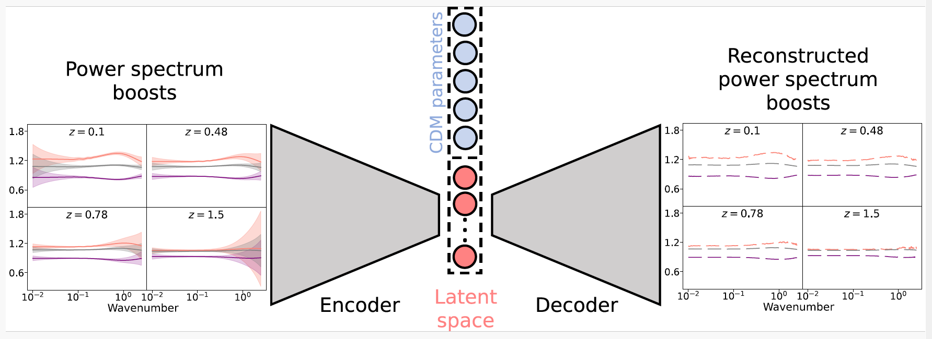
Representation learning
6
Notes:
Present yourself. You are going to talk about generative methods in Cosmology, as the title suggests. Mention other people that work with you.

Slide 27
Representation learning
some Data
6
Notes:
Present yourself. You are going to talk about generative methods in Cosmology, as the title suggests. Mention other people that work with you.

Slide 28
Representation learning
some Data
preDictions
6
Notes:
Present yourself. You are going to talk about generative methods in Cosmology, as the title suggests. Mention other people that work with you.

Slide 29
Representation learning
bottleneck
some Data
preDictions
6
Notes:
Present yourself. You are going to talk about generative methods in Cosmology, as the title suggests. Mention other people that work with you.

Slide 30
Representation learning
Power spectrum in extended model
Power spectrum boost =
Power spectrum in ΛCDM model
6
Notes:
Present yourself. You are going to talk about generative methods in Cosmology, as the title suggests. Mention other people that work with you.

Slide 31
Representation learning
Piras & Lombriser, arXiv 2310.10717
Power spectrum in extended model
Power spectrum boost =
Power spectrum in ΛCDM model
6
Notes:
Present yourself. You are going to talk about generative methods in Cosmology, as the title suggests. Mention other people that work with you.

Slide 32
Less is enough:
extending ΛCDM with representation learning
7
Notes:
Present yourself. You are going to talk about generative methods in Cosmology, as the title suggests. Mention other people that work with you.

Slide 33
parameters
Less is enough:
extending ΛCDM with representation learning
7
Notes:
Present yourself. You are going to talk about generative methods in Cosmology, as the title suggests. Mention other people that work with you.

Slide 34
An application to dark energy
Apply our framework to single extension: wCDM
8
Notes:
Present yourself. You are going to talk about generative methods in Cosmology, as the title suggests. Mention other people that work with you.

Slide 35
An application to dark energy
Apply our framework to single extension: wCDM
Two extra parameters: w₀ and w_{a}
8
Notes:
Present yourself. You are going to talk about generative methods in Cosmology, as the title suggests. Mention other people that work with you.

Slide 36
An application to dark energy
Apply our framework to single extension: wCDM
Two extra parameters: w₀ and w_{a}
Expect two latent variables are needed…?
8
Notes:
Present yourself. You are going to talk about generative methods in Cosmology, as the title suggests. Mention other people that work with you.

Slide 37
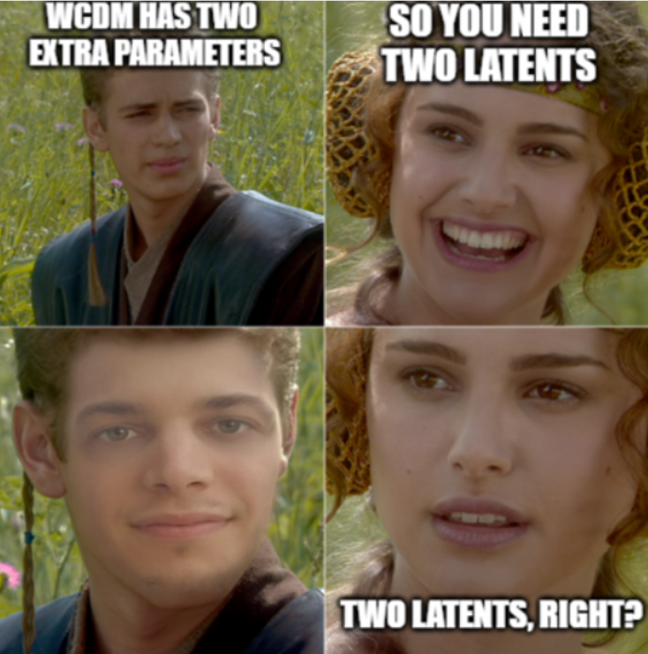
An application to dark energy
Apply our framework to single extension: wCDM
Two extra parameters: w₀ and w_{a}
8
Notes:
Present yourself. You are going to talk about generative methods in Cosmology, as the title suggests. Mention other people that work with you.

Slide 38
Results
9
Notes:
Present yourself. You are going to talk about generative methods in Cosmology, as the title suggests. Mention other people that work with you.

Slide 39
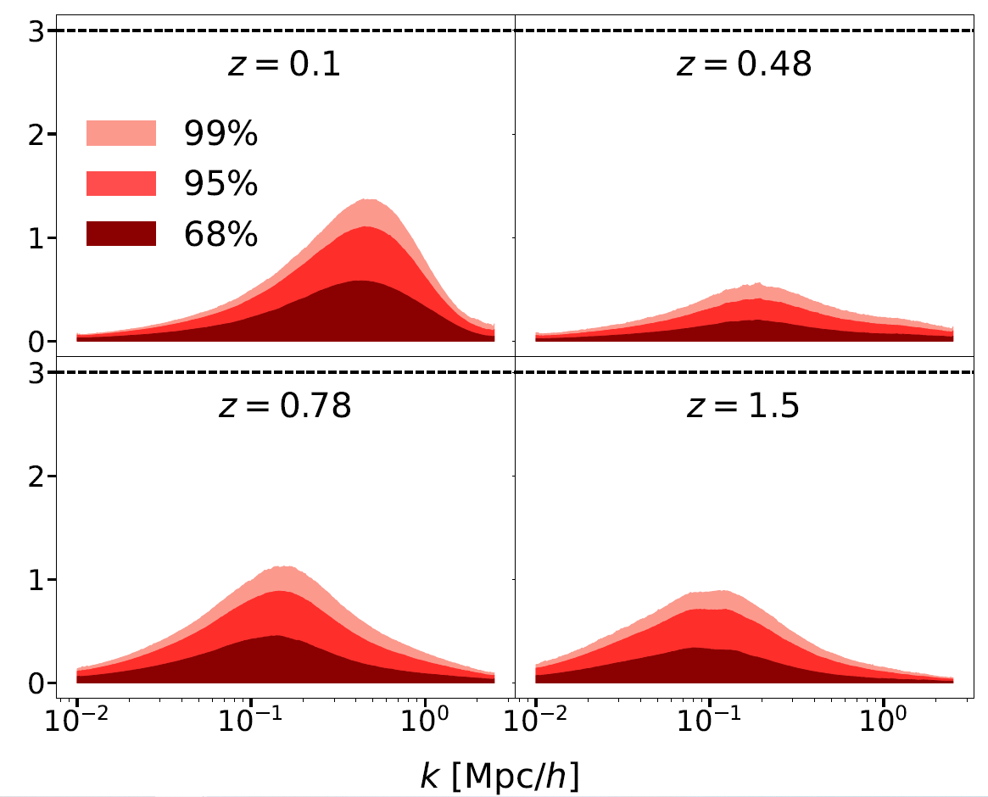
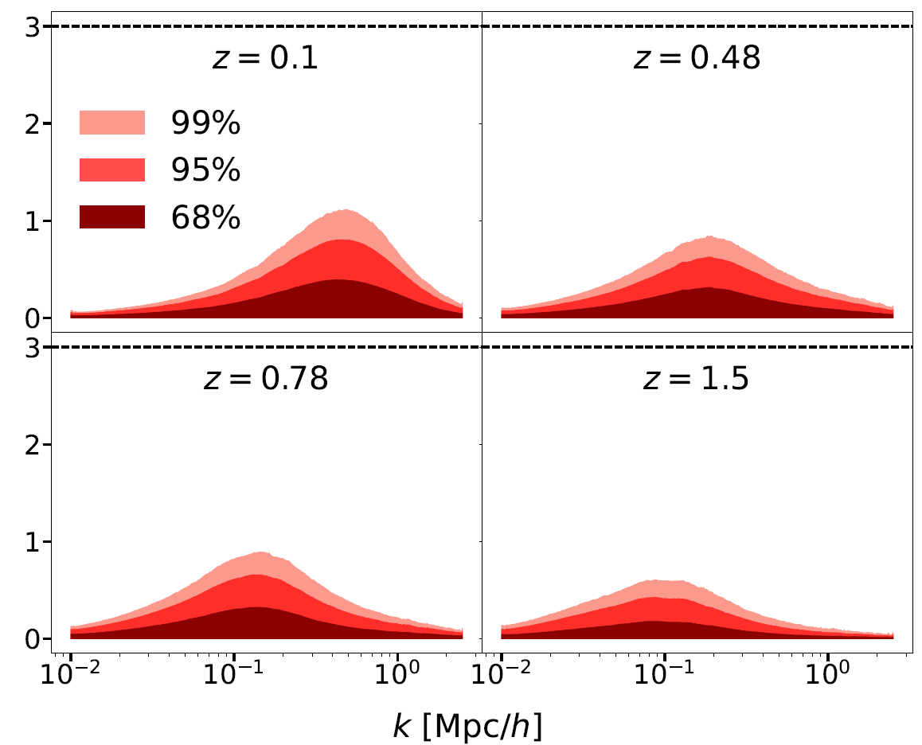
Results
One latent variable
Two latent variables
9
Notes:
Present yourself. You are going to talk about generative methods in Cosmology, as the title suggests. Mention other people that work with you.

Slide 40
Results
One latent variable
Two latent variables
Vertical axis: how many error bars is the predicted spectrum away from the ground truth? (lower is better)
9
Notes:
Present yourself. You are going to talk about generative methods in Cosmology, as the title suggests. Mention other people that work with you.

Slide 41
Results
One latent variable
Two latent variables
Vertical axis: how many error bars is the predicted spectrum away from the ground truth? (lower is better)
Results are pretty similar with one and two latents!
9
Notes:
Present yourself. You are going to talk about generative methods in Cosmology, as the title suggests. Mention other people that work with you.

Slide 42
Results
One latent variable
Two latent variables
Vertical axis: how many error bars is the predicted spectrum away from the ground truth? (lower is better)
Results are pretty similar with one and two latents!
Third disentangled latent: no impact (not shown)
9
Notes:
Present yourself. You are going to talk about generative methods in Cosmology, as the title suggests. Mention other people that work with you.

Slide 43
Results
One latent variable
Two latent variables
Vertical axis: how many error bars is the predicted spectrum away from the ground truth? (lower is better)
Results are pretty similar with one and two latents!
Third disentangled latent: no impact (not shown)
One variable is enough for wCDM!
9
Notes:
Present yourself. You are going to talk about generative methods in Cosmology, as the title suggests. Mention other people that work with you.

Slide 44
How to analyse the latent space?
10
Notes:
Present yourself. You are going to talk about generative methods in Cosmology, as the title suggests. Mention other people that work with you.

Slide 45
How to analyse the latent space?
Mutual information
10
Notes:
Present yourself. You are going to talk about generative methods in Cosmology, as the title suggests. Mention other people that work with you.

Slide 46
What is mutual information?
Measures dependence between random variables (more general than Pearson, which measures correlation)
11
Notes:
Present yourself. You are going to talk about generative methods in Cosmology, as the title suggests. Mention other people that work with you.

Slide 47
What is mutual information?
Measures dependence between random variables (more general than Pearson, which measures correlation)
Well-established in information theory
11
Notes:
Present yourself. You are going to talk about generative methods in Cosmology, as the title suggests. Mention other people that work with you.

Slide 48
What is mutual information?
Measures dependence between random variables (more general than Pearson, which measures correlation)
Well-established in information theory
Hard to estimate!
11
Notes:
Present yourself. You are going to talk about generative methods in Cosmology, as the title suggests. Mention other people that work with you.

Slide 49
Estimating mutual information (MI)
No available estimator returns uncertainty on MI
12
Notes:
Present yourself. You are going to talk about generative methods in Cosmology, as the title suggests. Mention other people that work with you.

Slide 50
Estimating mutual information (MI)
No available estimator returns uncertainty on MI
Solution: density estimate with Gaussian mixture model
“Jimmie”
12
Notes:
Present yourself. You are going to talk about generative methods in Cosmology, as the title suggests. Mention other people that work with you.

Slide 51
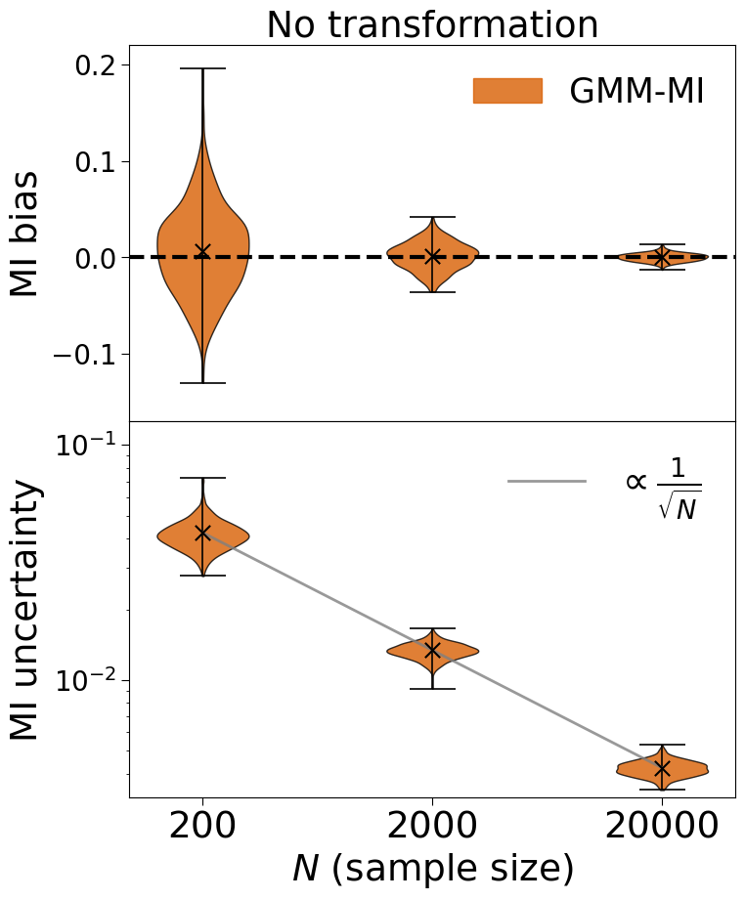
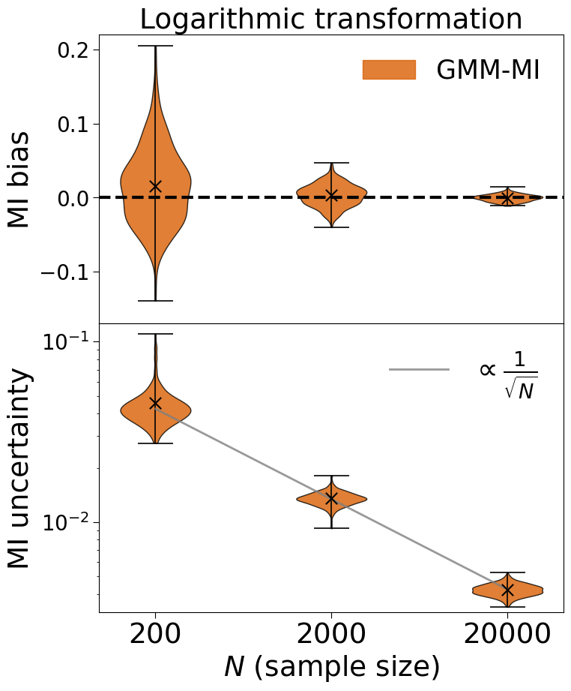
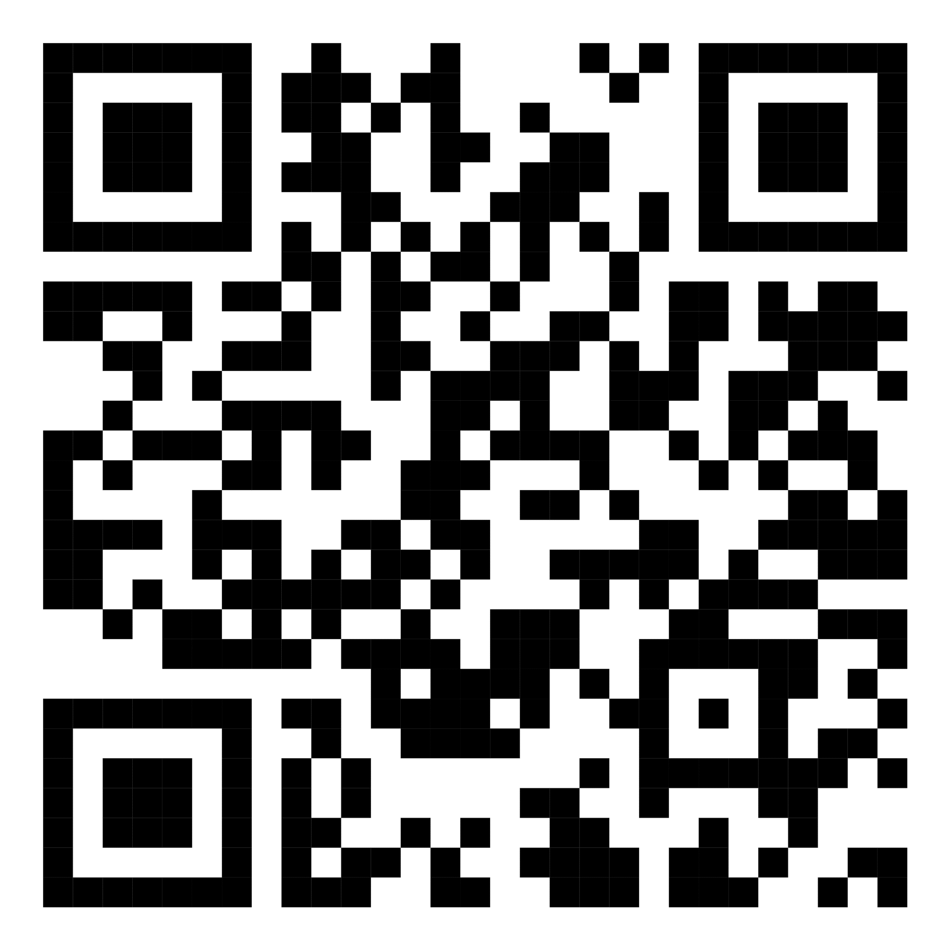
GMM-MI validation
Piras et al. (including Hiranya Peiris, Andrew Pontzen, Luisa Lucie-Smith, Lillian Guo, Brian Nord), MLST
Code
Ask me later!
13
Notes:
Present yourself. You are going to talk about generative methods in Cosmology, as the title suggests. Mention other people that work with you.

Slide 52
How we use mutual information (MI)
Calculate MI between latent variables (are they disentangled?)
Latent A
Latent B
14
Notes:
Present you and work. Mention collaborators. Mention that you are open to questions, and that data science includes ML, etc.

Slide 53
How we use mutual information (MI)
Calculate MI between latent variables (are they disentangled?)
Calculate MI between a latent variable and model parameters
Latent A
Latent B
Latent A
w_{0 ,} w_{a}
14
Notes:
Present you and work. Mention collaborators. Mention that you are open to questions, and that data science includes ML, etc.

Slide 54
Mutual information in latent space
Latent variable has significant MI with wCDM parameters
latent variable
15
Notes:
Present yourself. You are going to talk about generative methods in Cosmology, as the title suggests. Mention other people that work with you.

Slide 55
Mutual information in latent space
Latent variable has significant MI with wCDM parameters
Little-to-no MI with other parameters (not shown)
latent variable
15
Notes:
Present yourself. You are going to talk about generative methods in Cosmology, as the title suggests. Mention other people that work with you.

Slide 56
Mutual information in latent space
Latent variable has significant MI with wCDM parameters
Little-to-no MI with other parameters (not shown)
Third latent variable is unused
15
Notes:
Present yourself. You are going to talk about generative methods in Cosmology, as the title suggests. Mention other people that work with you.

Slide 57
How to analyse the latent space?
Mutual information
Symbolic regression
16
Notes:
Present yourself. You are going to talk about generative methods in Cosmology, as the title suggests. Mention other people that work with you.

Slide 58
What is symbolic regression?
Check out review on symbolic regression on Wednesday
17
Notes:
Present yourself. You are going to talk about generative methods in Cosmology, as the title suggests. Mention other people that work with you.

Slide 59
Symbolic regression in latent space
Link latent variable and wCDM parameters
Less accurate, but more interpretable (?)
18
Notes:
Present yourself. You are going to talk about generative methods in Cosmology, as the title suggests. Mention other people that work with you.

Slide 60
Symbolic regression in latent space
Link latent variable and wCDM parameters
Less accurate, but more interpretable (?)
latent variable
18
Notes:
Present yourself. You are going to talk about generative methods in Cosmology, as the title suggests. Mention other people that work with you.

Slide 61
Symbolic regression in latent space
Link latent variable and wCDM parameters
Less accurate, but more interpretable (?)
Analogous to S₈ = σ₈(Ω_{m}/0.3)^{0.5} …?
18
Notes:
Present yourself. You are going to talk about generative methods in Cosmology, as the title suggests. Mention other people that work with you.

Slide 62
Conclusions
Only need one variable to describe wCDM matter power spectra
19

Slide 63
Conclusions
Only need one variable to describe wCDM matter power spectra
Can use mutual information and symbolic regression to interpret latent space
19

Slide 64
Conclusions
Only need one variable to describe wCDM matter power spectra
Can use mutual information and symbolic regression to interpret latent space
Will apply our framework to multiple extensions and different summaries
19

Slide 65
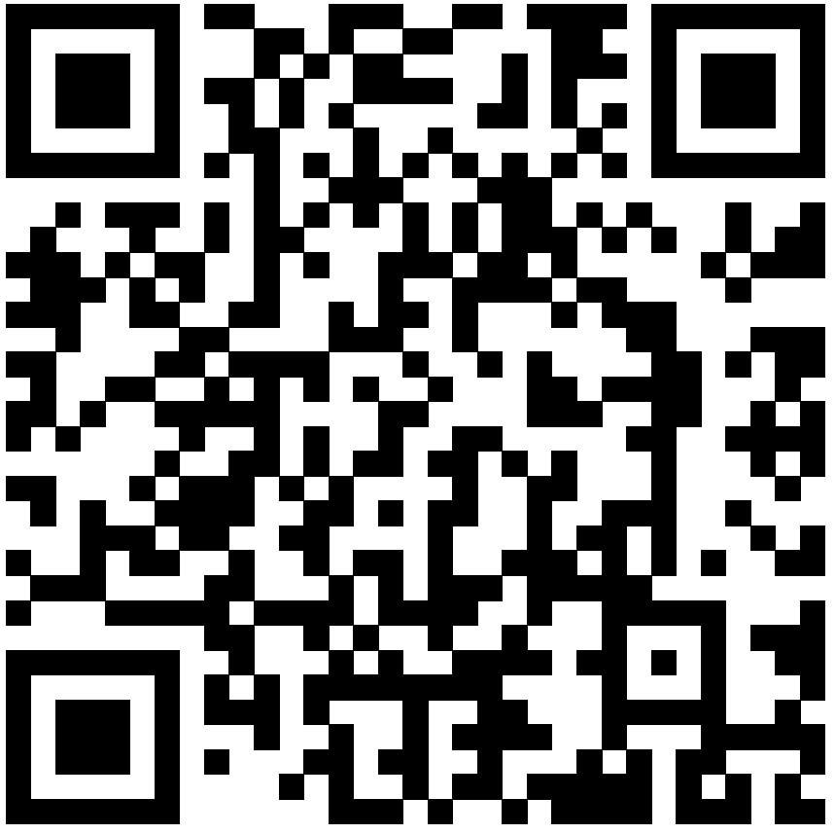
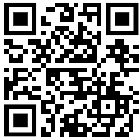
Cheeky ad
Check out our poster
on accelerated Bayesian inference
with CosmoPower-JAX
Video
Code

Slide 66
Conclusions
Only need one variable to describe wCDM matter power spectra
Can use mutual information and symbolic regression to interpret latent space
Will apply our framework to multiple extensions and different summaries
Thank you

Slide 67
Extra slides (and memes)

Slide 68
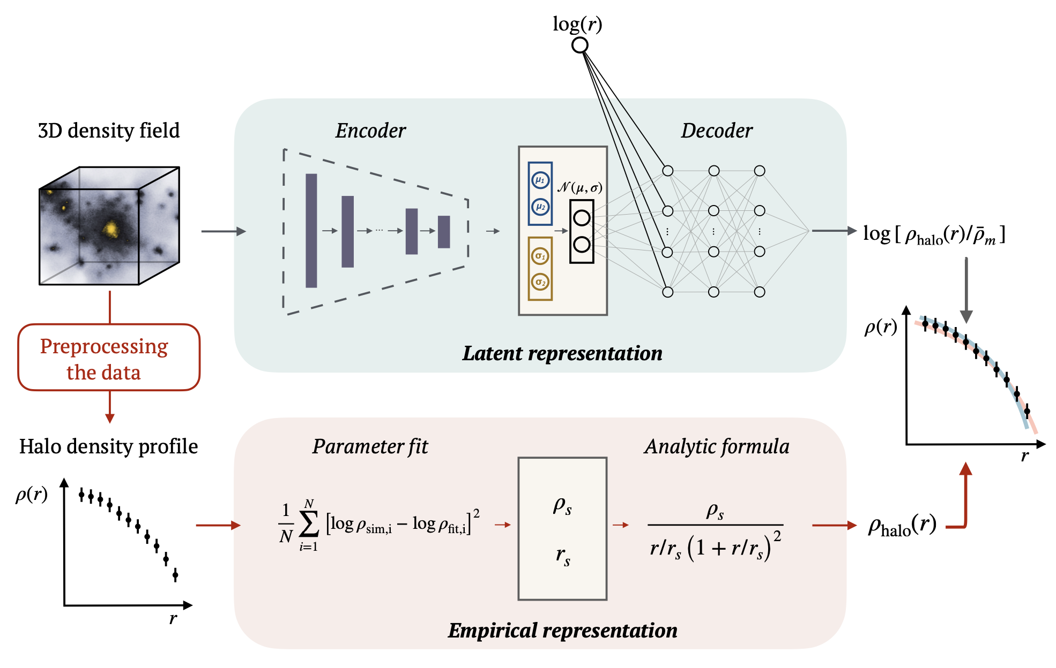
Representation learning in cosmological structure formation
Single halo from N-body simulation
Navarro-Frenk-White profile
Lucie-Smith et al., 105, 103533, PRD
Notes:
Present yourself. You are going to talk about generative methods in Cosmology, as the title suggests. Mention other people that work with you.

Slide 69
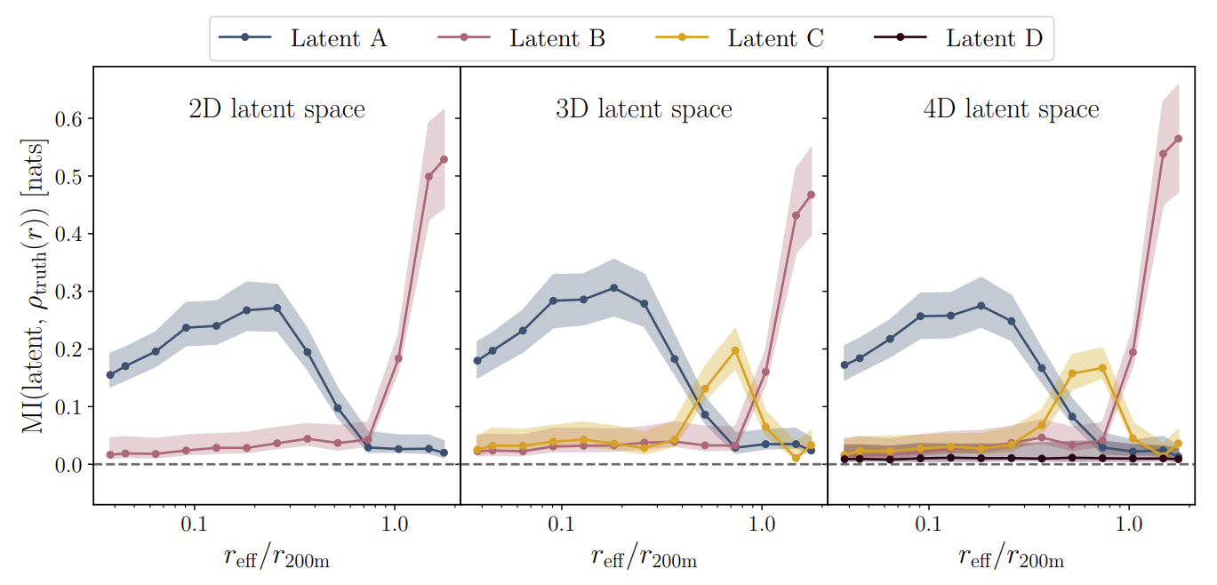
Application to cosmological structure formation
Lucie-Smith et al., 105, 103533, PRD
Notes:
Present yourself. You are going to talk about generative methods in Cosmology, as the title suggests. Mention other people that work with you.

Slide 70
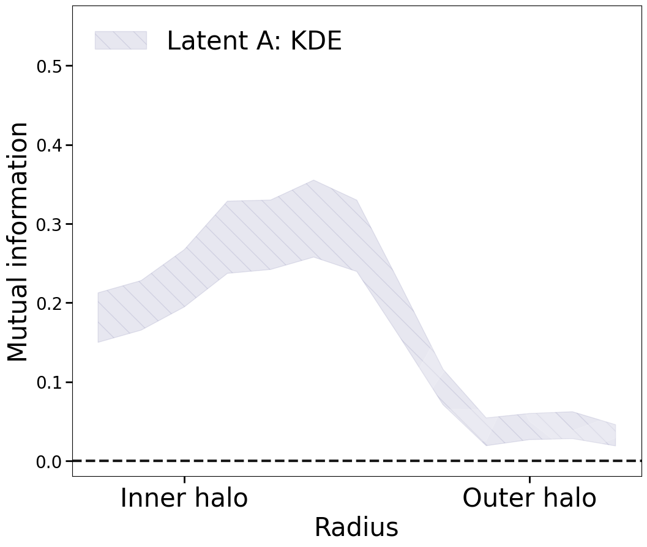
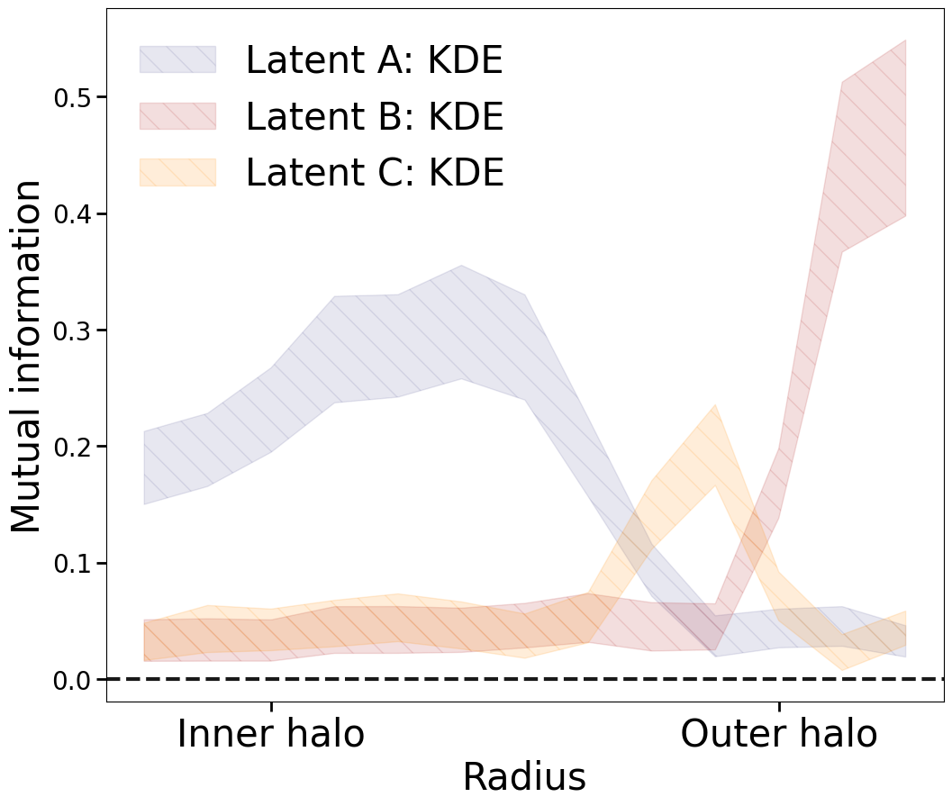
Explore dependence of latent variables
Latent A
Latent B
Latent C
Mutual information
Density at each radius
KDE :=
kernel density estimation
Notes:
Present yourself. You are going to talk about generative methods in Cosmology, as the title suggests. Mention other people that work with you.

Slide 71
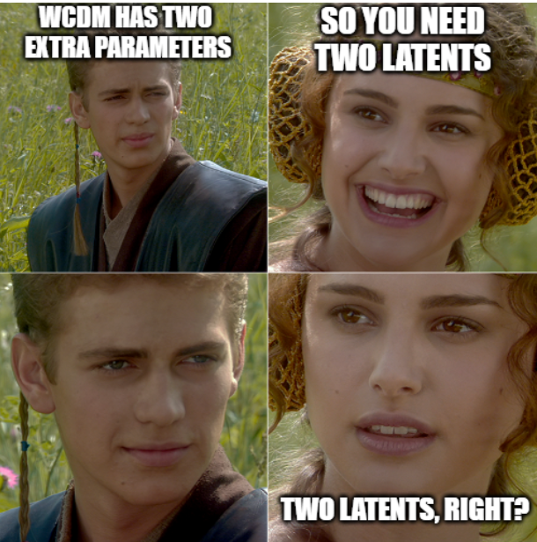
An application to dark energy
Apply our framework to single extension: wCDM
Two extra parameters: w₀ and w_{a}
Expect two latent variables are needed…?
Notes:
Present yourself. You are going to talk about generative methods in Cosmology, as the title suggests. Mention other people that work with you.

Slide 72
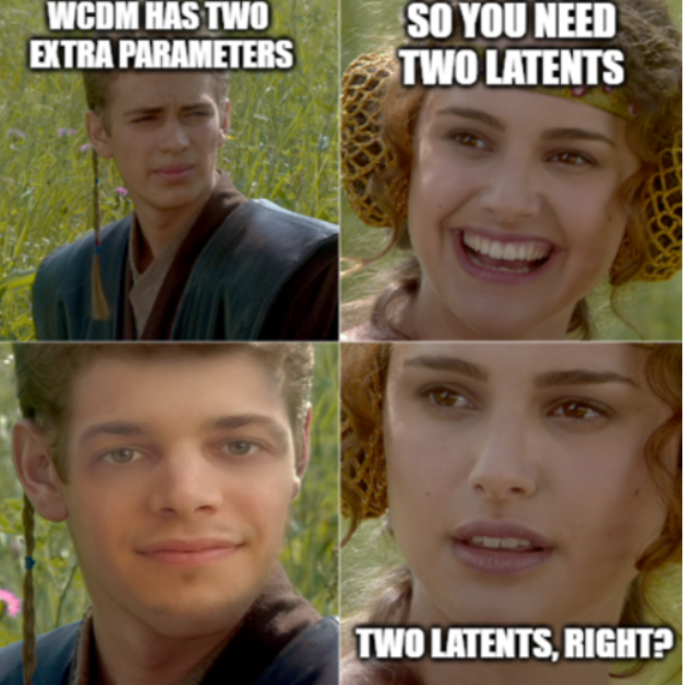
An application to dark energy
Apply our framework to single extension: wCDM
Two extra parameters: w₀ and w_{a}
Expect two latent variables are needed…?
Notes:
Present yourself. You are going to talk about generative methods in Cosmology, as the title suggests. Mention other people that work with you.

Slide 73
Results
One latent variable
Two latent variables
Notes:
Present yourself. You are going to talk about generative methods in Cosmology, as the title suggests. Mention other people that work with you.

Slide 74
Results
One latent variable
Two latent variables
YONOV: You Only Need One Variable
Notes:
Present yourself. You are going to talk about generative methods in Cosmology, as the title suggests. Mention other people that work with you.

Slide 75
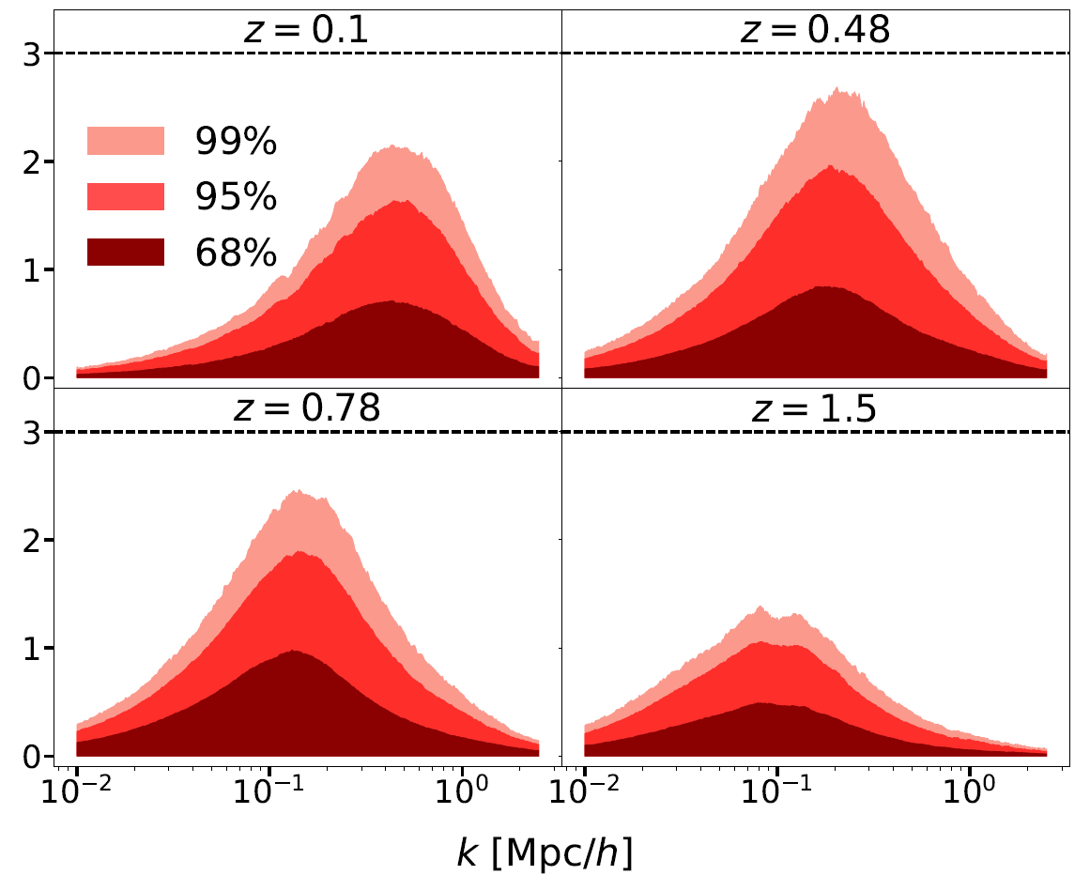
Symbolic regression results
Notes:
Present yourself. You are going to talk about generative methods in Cosmology, as the title suggests. Mention other people that work with you.

Slide 76
What is mutual information?
Measures dependence between random variables (more general than Pearson, which measures correlation)
Well-established in information theory
Defined by :
if and only if and are independent
Notes:
Present yourself. You are going to talk about generative methods in Cosmology, as the title suggests. Mention other people that work with you.

Slide 77
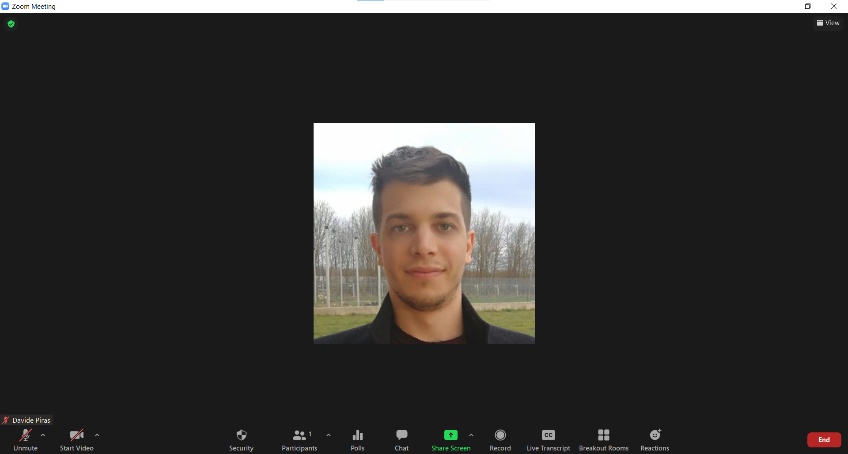
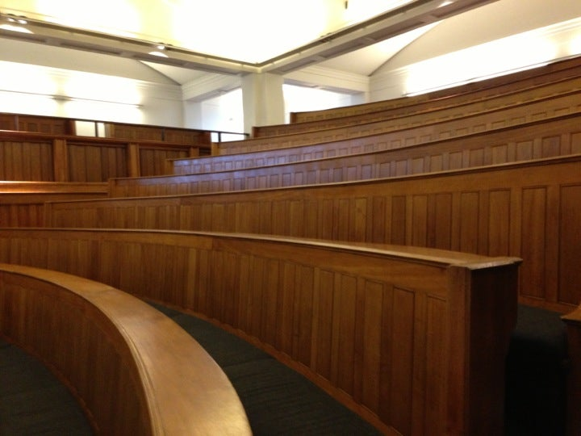
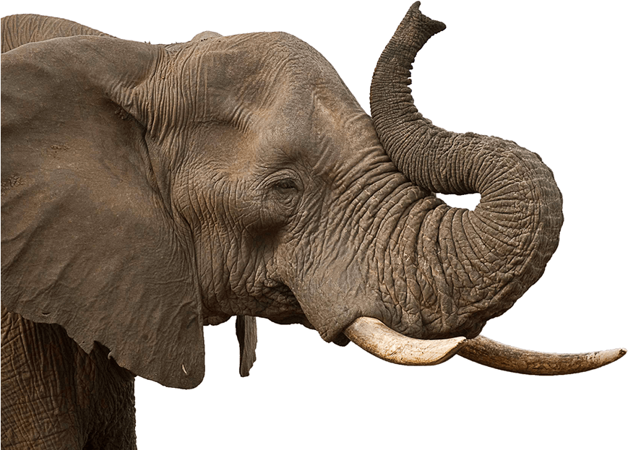
The elephant in the room
Notes:
Present yourself. You are going to talk about generative methods in Cosmology, as the title suggests. Mention other people that work with you.

Slide 78
GMM-MI: a robust estimator of mutual information
Cross-validation and multiple initialisations to optimise fit
Notes:
Present yourself. You are going to talk about generative methods in Cosmology, as the title suggests. Mention other people that work with you.

Slide 79
GMM-MI: a robust estimator of mutual information
Cross-validation and multiple initialisations to optimise fit
Works with continuous and discrete variables
Notes:
Present yourself. You are going to talk about generative methods in Cosmology, as the title suggests. Mention other people that work with you.

Slide 80
GMM-MI: a robust estimator of mutual information
Cross-validation and multiple initialisations to optimise fit
Works with continuous and discrete variables
GMM-MI returns uncertainty on MI through bootstrapping
Notes:
Present yourself. You are going to talk about generative methods in Cosmology, as the title suggests. Mention other people that work with you.

Slide 81
GMM-MI at work
Notes:
Present yourself. You are going to talk about generative methods in Cosmology, as the title suggests. Mention other people that work with you.

Slide 82
GMM-MI at work
Notes:
Present yourself. You are going to talk about generative methods in Cosmology, as the title suggests. Mention other people that work with you.

Slide 83
GMM-MI at work
Notes:
Present yourself. You are going to talk about generative methods in Cosmology, as the title suggests. Mention other people that work with you.

Slide 84
GMM-MI at work
Notes:
Present yourself. You are going to talk about generative methods in Cosmology, as the title suggests. Mention other people that work with you.

Slide 85
GMM-MI validation
Piras et al., MLST
GMM-MI is unbiased
Notes:
Present yourself. You are going to talk about generative methods in Cosmology, as the title suggests. Mention other people that work with you.

Slide 86
GMM-MI validation
Piras et al., MLST
GMM-MI is unbiased
GMM-MI respects MI invariance
Notes:
Present yourself. You are going to talk about generative methods in Cosmology, as the title suggests. Mention other people that work with you.

Slide 87
GMM-MI validation
Piras et al., MLST
GMM-MI is unbiased
GMM-MI respects MI invariance
GMM-MI errors scale as expected
Notes:
Present yourself. You are going to talk about generative methods in Cosmology, as the title suggests. Mention other people that work with you.

Slide 88
What is symbolic regression?
Finds analytic equation linking variables
17
Notes:
Present yourself. You are going to talk about generative methods in Cosmology, as the title suggests. Mention other people that work with you.

Slide 89
What is symbolic regression?
Finds analytic equation linking variables
Less accurate, but more interpretable (?)
Notes:
Present yourself. You are going to talk about generative methods in Cosmology, as the title suggests. Mention other people that work with you.

Slide 90
What is symbolic regression?
Finds analytic equation linking variables
Less accurate, but more interpretable (?)
Many implementations available
Notes:
Present yourself. You are going to talk about generative methods in Cosmology, as the title suggests. Mention other people that work with you.

Slide 91
Material

Slide 92
Representation learning
bottleneck
some Data
preDictions
Notes:
Present yourself. You are going to talk about generative methods in Cosmology, as the title suggests. Mention other people that work with you.

