Slide 1
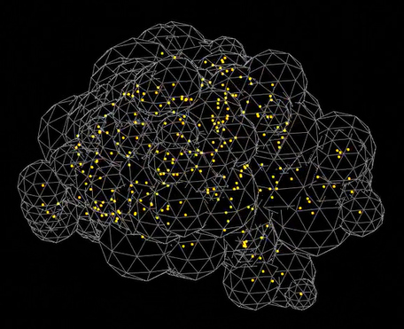
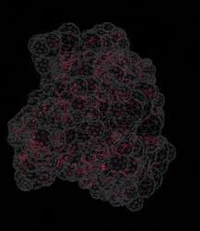
Machine-learning Cosmology from Void Properties
Bonny Y. Wang
Carnegie Mellon University / Center for Computational Astrophysics
November 28th 2023
In collaboration with Alice Pisani, Francisco Villaescusa-Navarro,Benjamin D. Wandelt

Slide 2
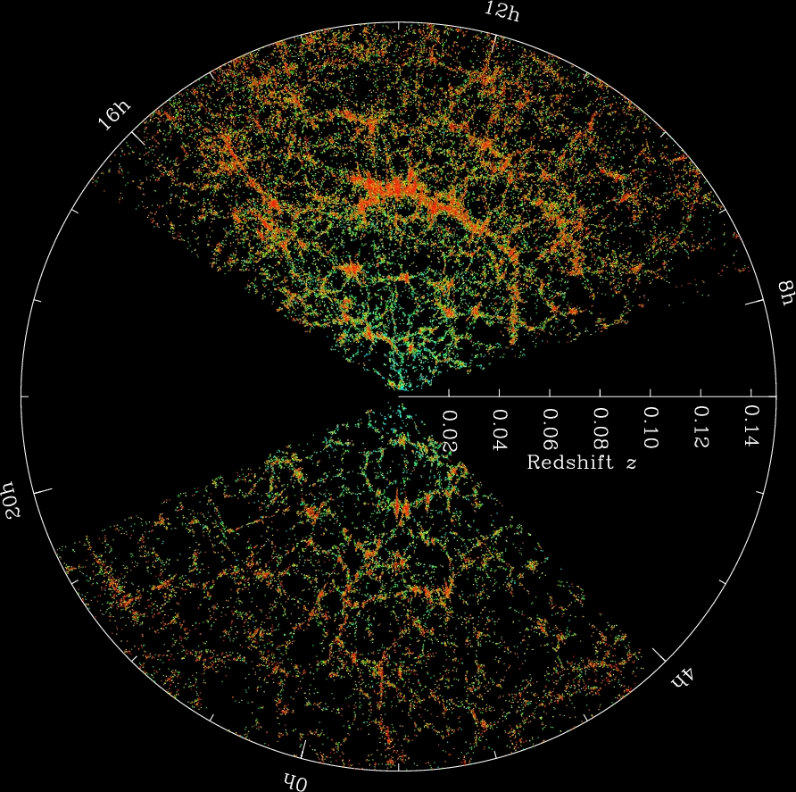
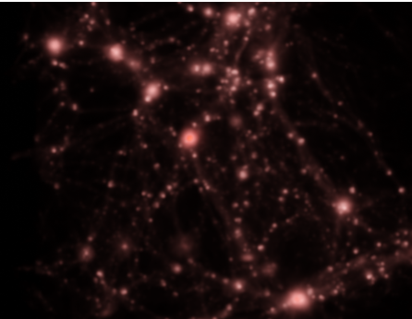
Cosmic voids
https://www.sdss4.org/wp-content/uploads/2014/06/orangepie.jpg
Notes:
At large scale say 100 Mpc
Sloan Digital Sky Survey
Dark Energy Counteracts gravity
Filaments
Vast space (not empty but very low density and contain only a few galaxies) inbetween fillament

Slide 3
Current constraints from Voids with the BOSS Survey
The void-galaxy cross-correlation function (Hamaus et al. 2020)
Ω_{m} = 0.310 ±5%
The void size function (Contarini et al. 2022)
Ω_{m} =
σ₈ =
Notes:
The BOSS survey (Alam et al. 2017), whose volume is much larger than the volume of the simulation box we used in this work—it is therefore expected that we have a larger error

Slide 4
Outline
Machine
Learning Models
Cosmological Parameters
Void Data
Void Ellipticity
Void Density Contrast
Void Radius
The mean and standard deviation of the posterior distribution
Notes:
There are some models exist but still under-explored statistics, and for those machine learning are great for those

Slide 5
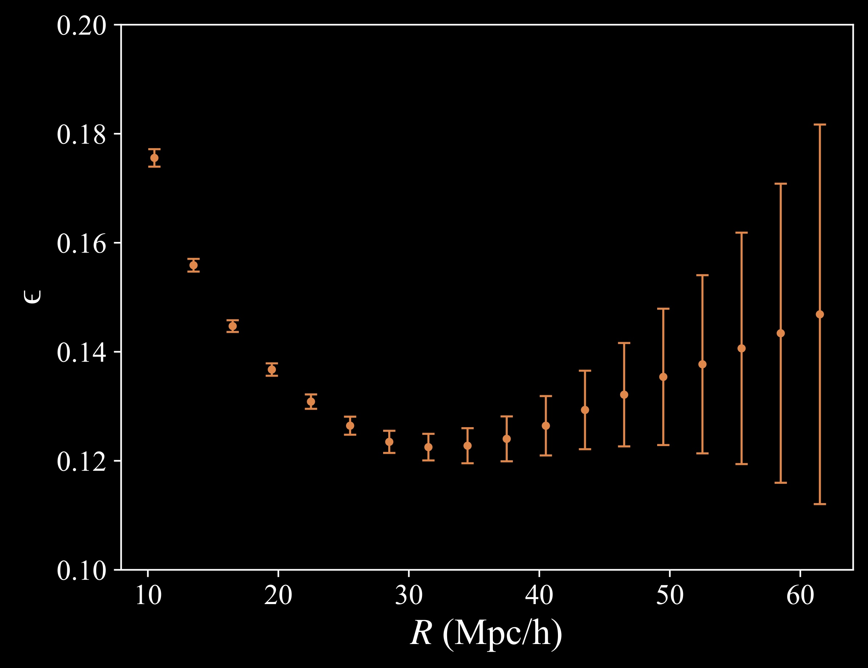
Notes:
Let’s understand these properties first

Slide 6
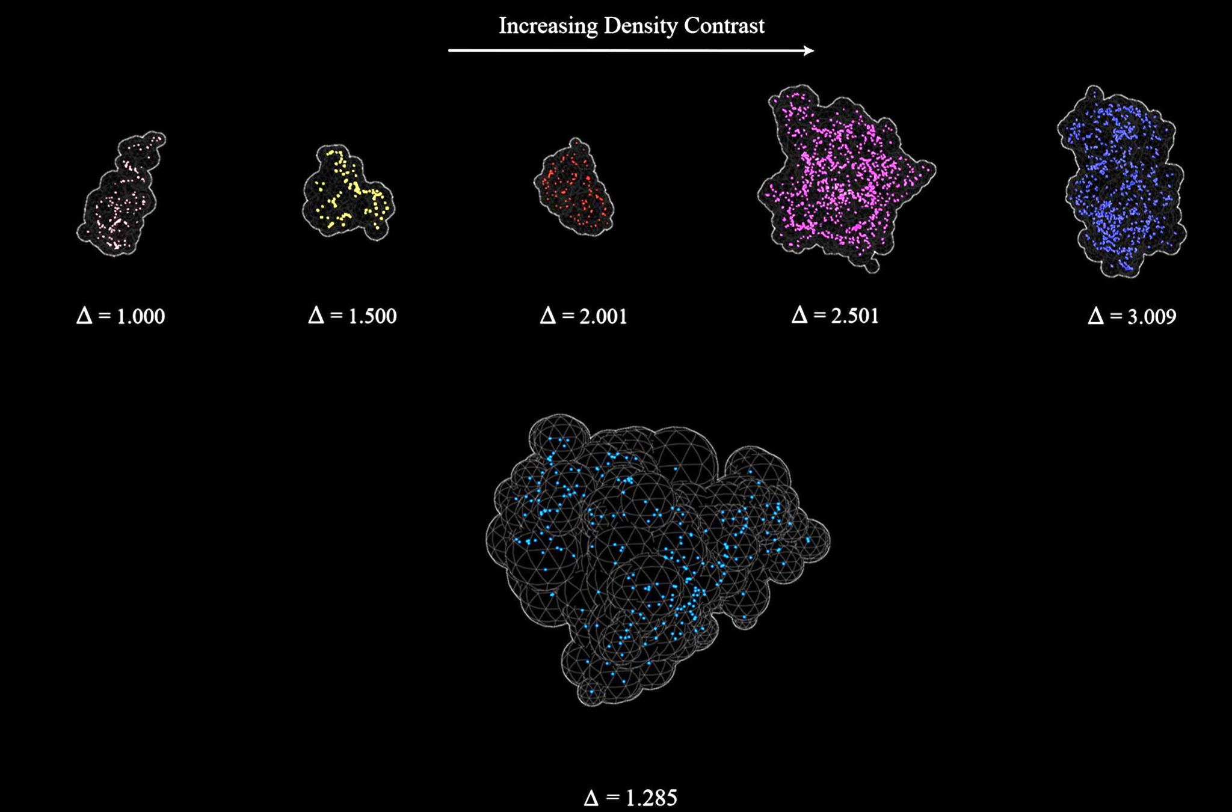
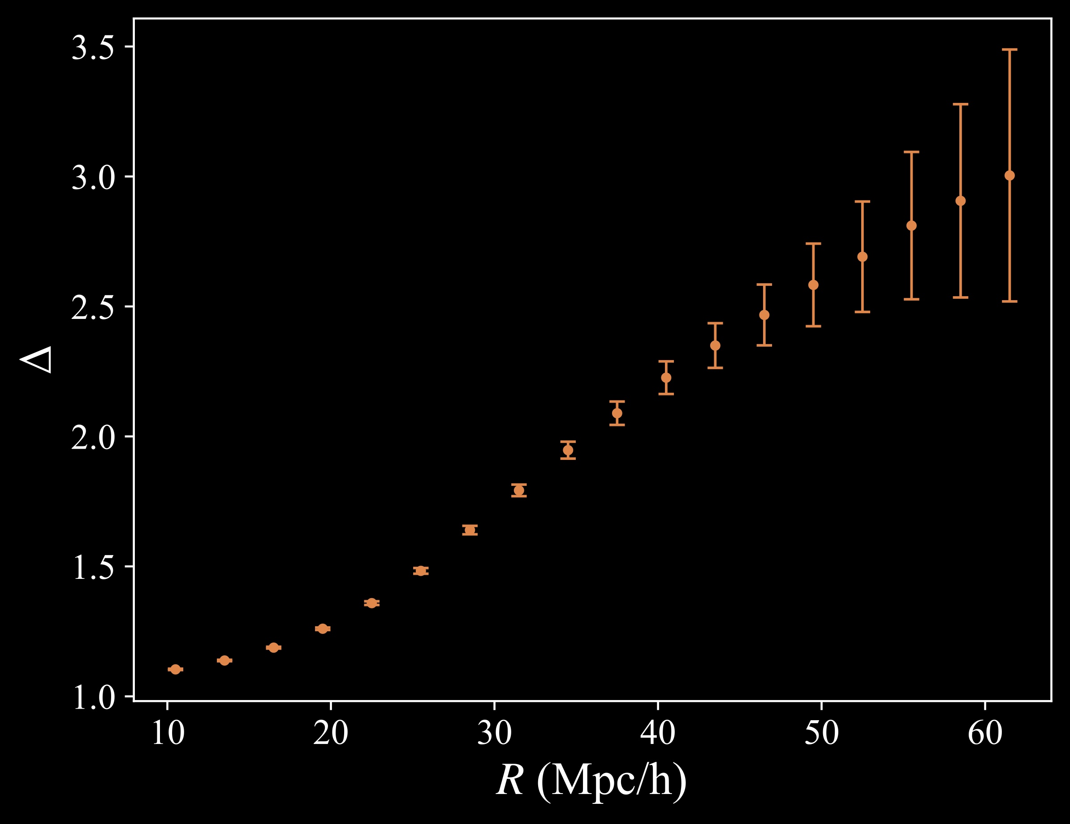
Density Contrast:
The ratio of the minimum density along the ridge of the void versus the minimum density in the void

Slide 7
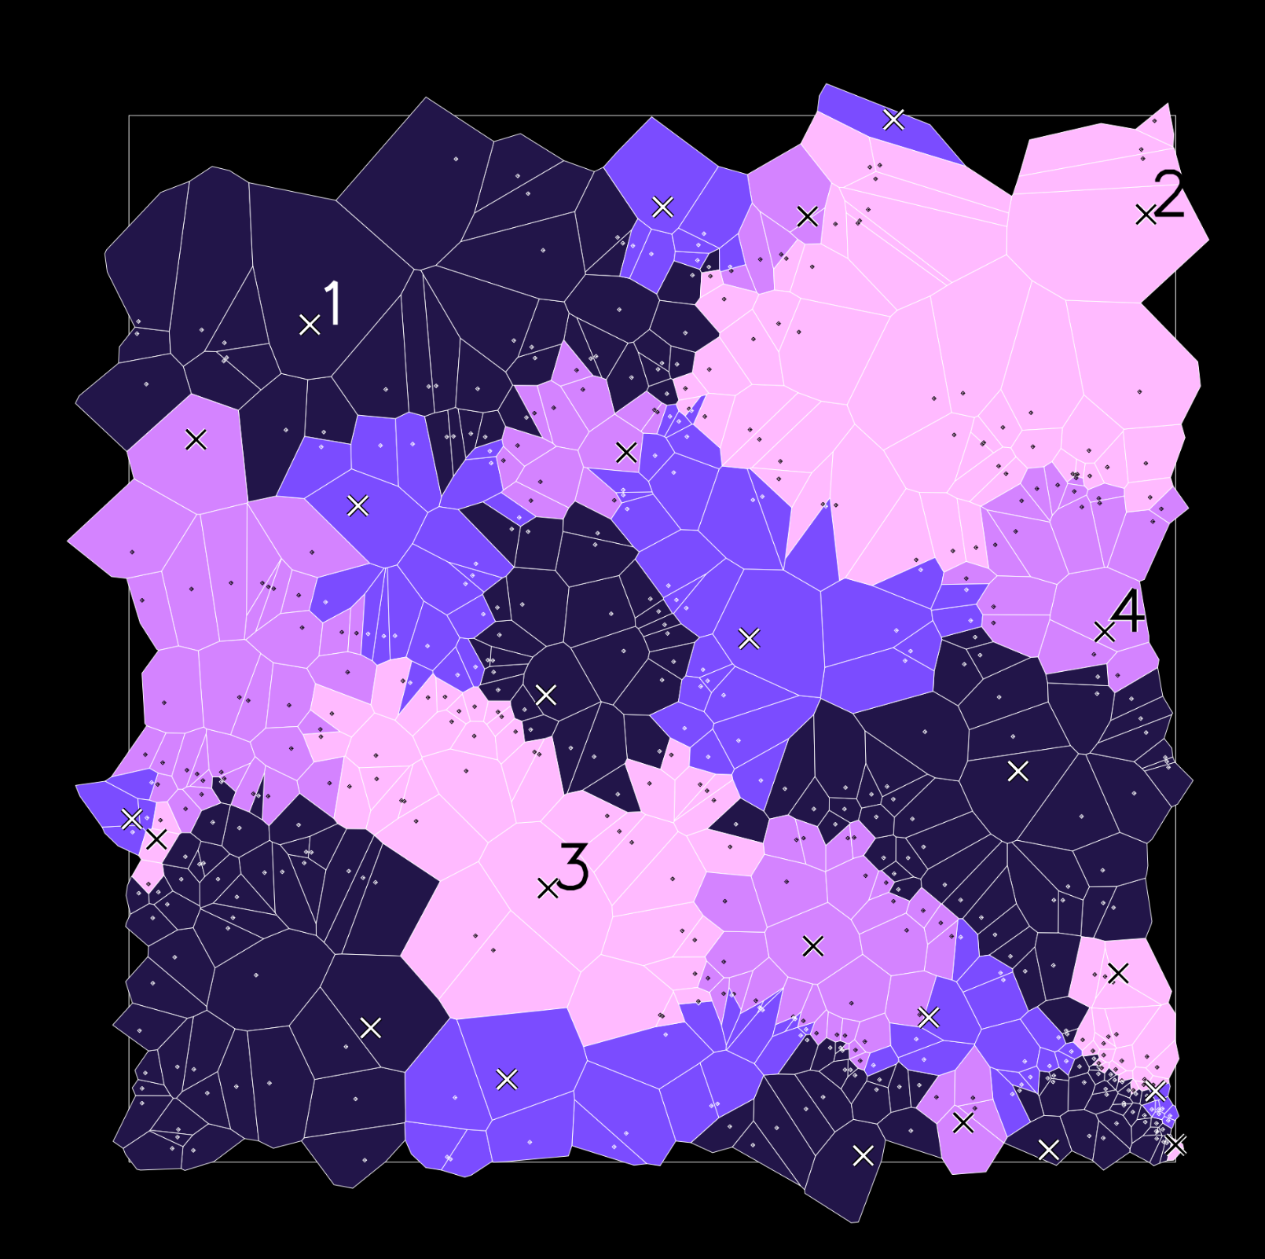
Dataset - GIGANTES
https://gigantes.readthedocs.io
(Kreisch et al. 2021)
Created by applying VIDE void finder (halo field) on QUIJOTE simulation
(Villaescusa-Navarro et al. 2020, Sutter et al. 2015, Neyrinck 2008)

Slide 8
Loss Function:
Jeffrey & Wandelt 2020

Slide 9
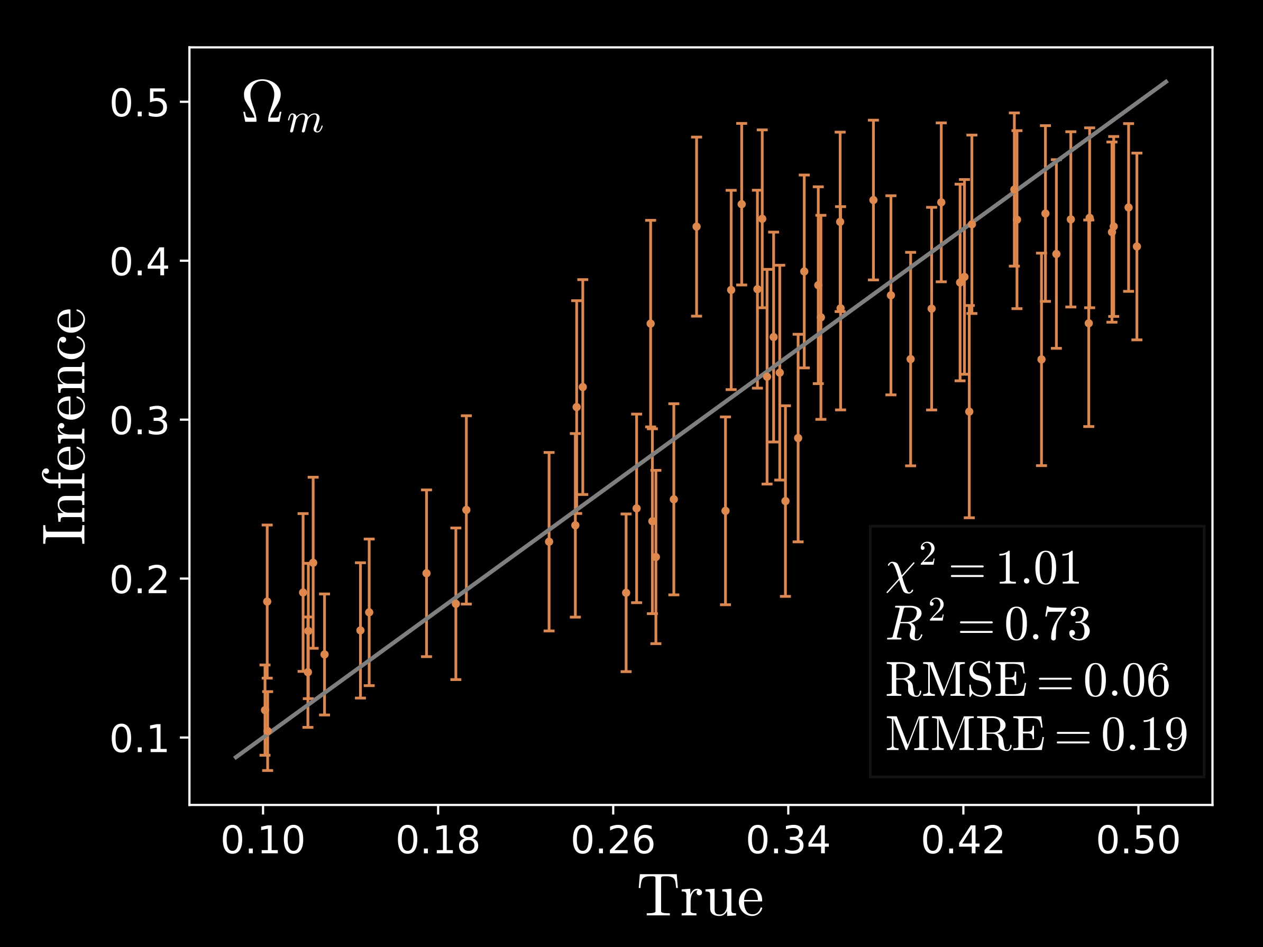
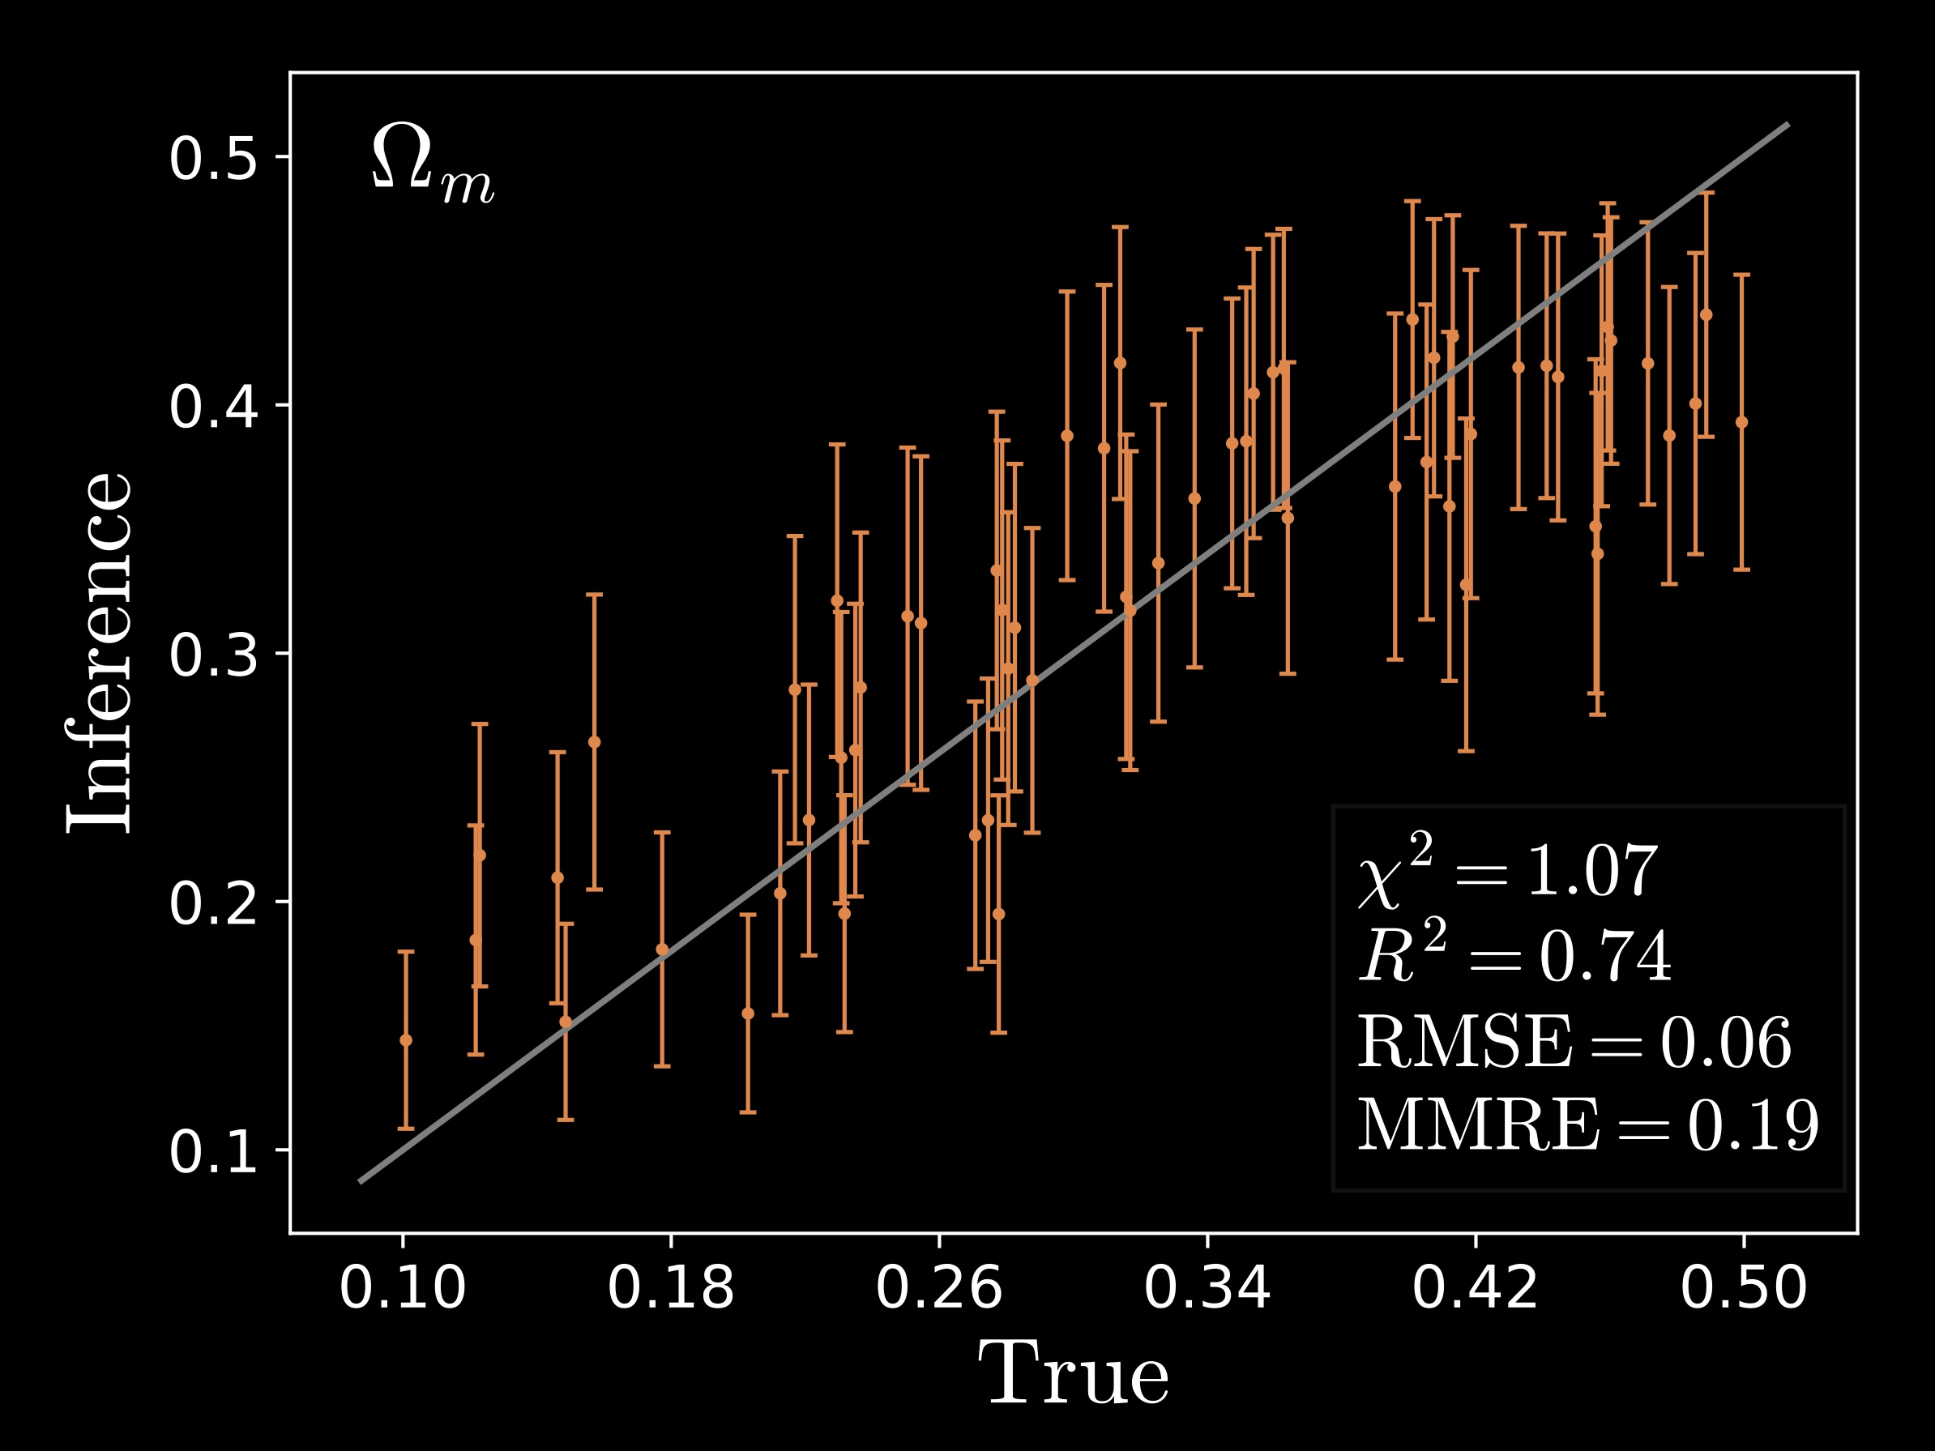
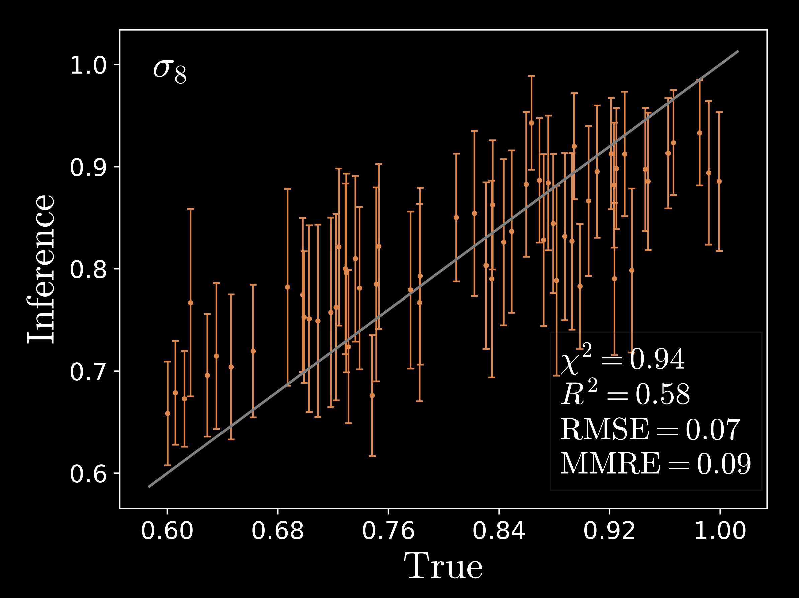
Histograms of Void Density Contrast
Histograms of Void Ellipticity

Slide 10
(Zaheer et al. 2017)
Notes:
Since void data has a set nature

Slide 11
Using Void Ellipticity, Density Contrast, Radius with Deep Sets
10% 4% 3%

Slide 12
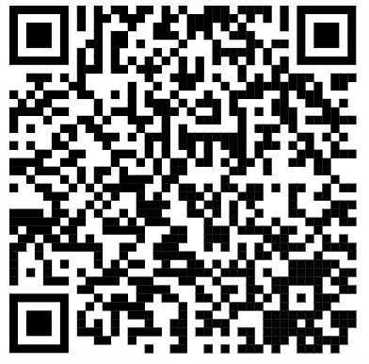
Future Works
Use voids in redshift space
Combine voids with traditional statistics (such as clusters)
Test robustness on different simulations
Apply to real surveys
DESI, Euclid , Roman, SPHEREx, and PFS
Thank you!

