Slide 1
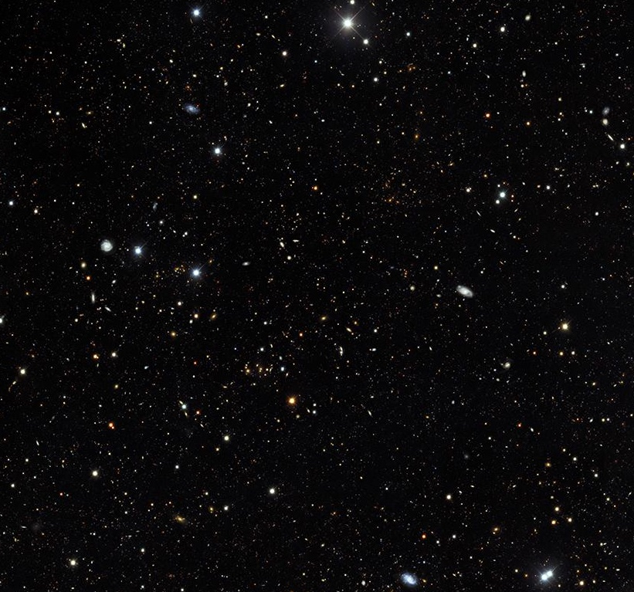
Machine Learning for New Physics
Agnès Ferté
SLAC/KIPAC

Slide 2
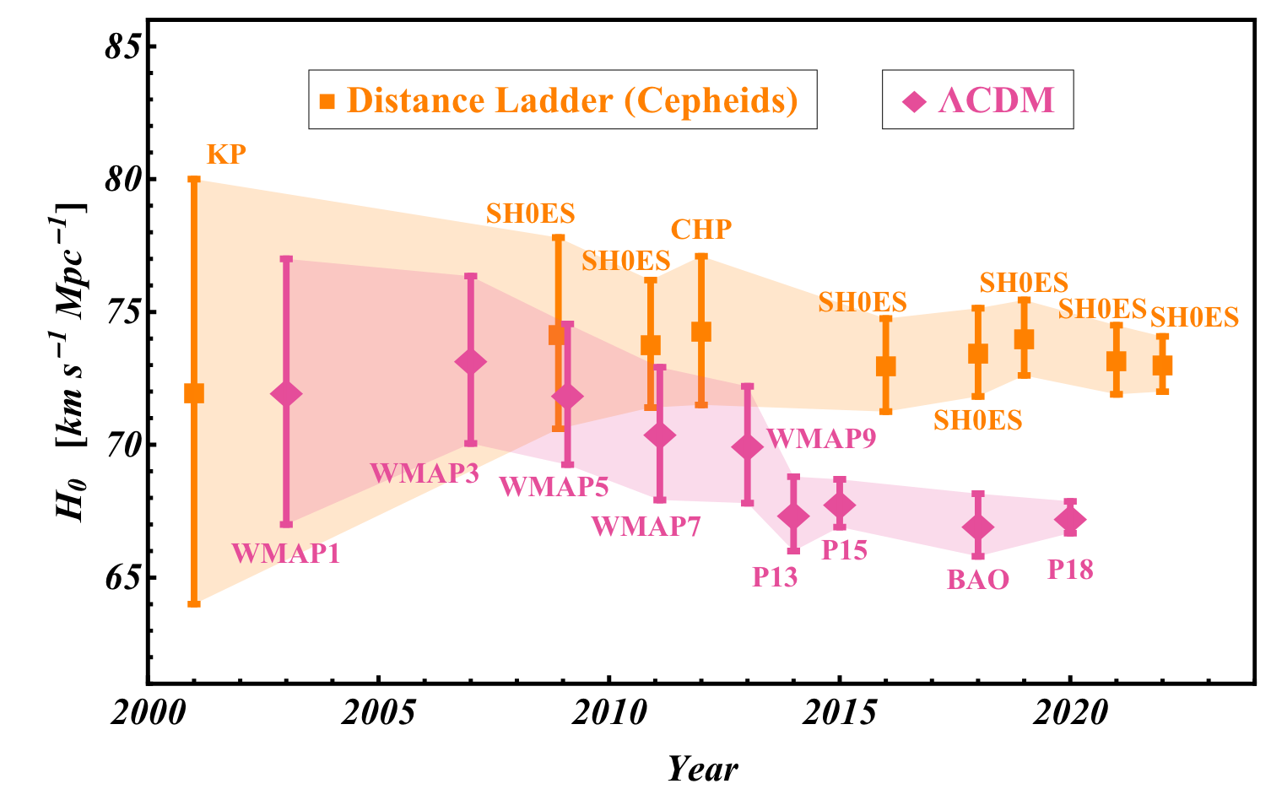
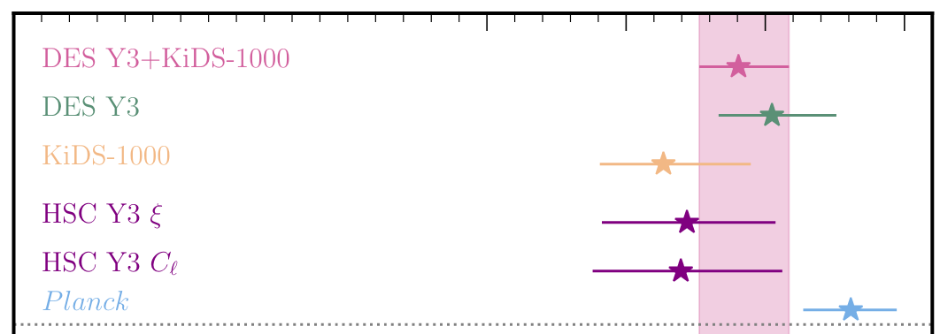
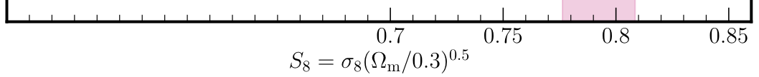
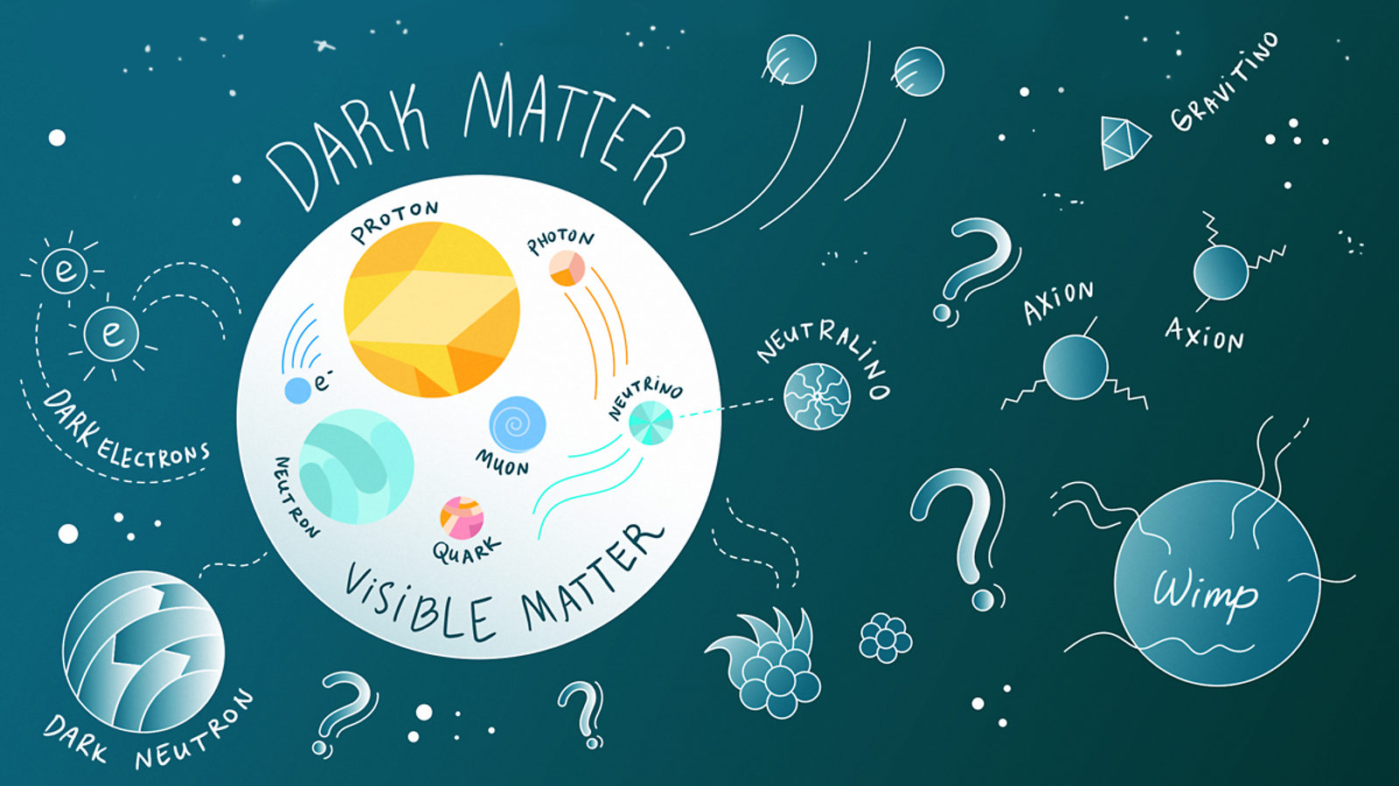
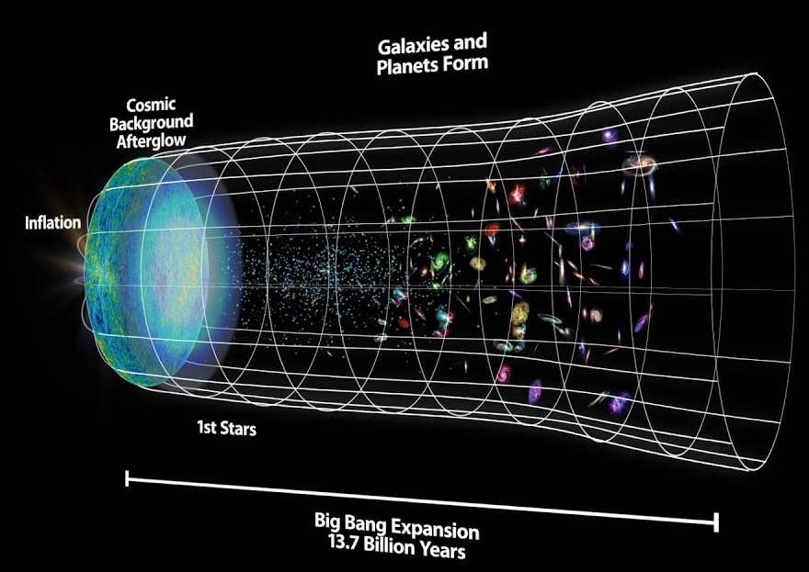
Search for new physics with cosmological surveys
The H₀ tension
The σ₈ tension
DES Collaboration, OJA, 2023
Perivolaropoulos, Skara, New A R, 2022
Neutrinos, dark matter
Accelerated expansion
?
?
Sandbox Studio, Chicago with Ana Kova
Agnès Ferté @ ML IAP/CCA – Nov 2023
2

Slide 3
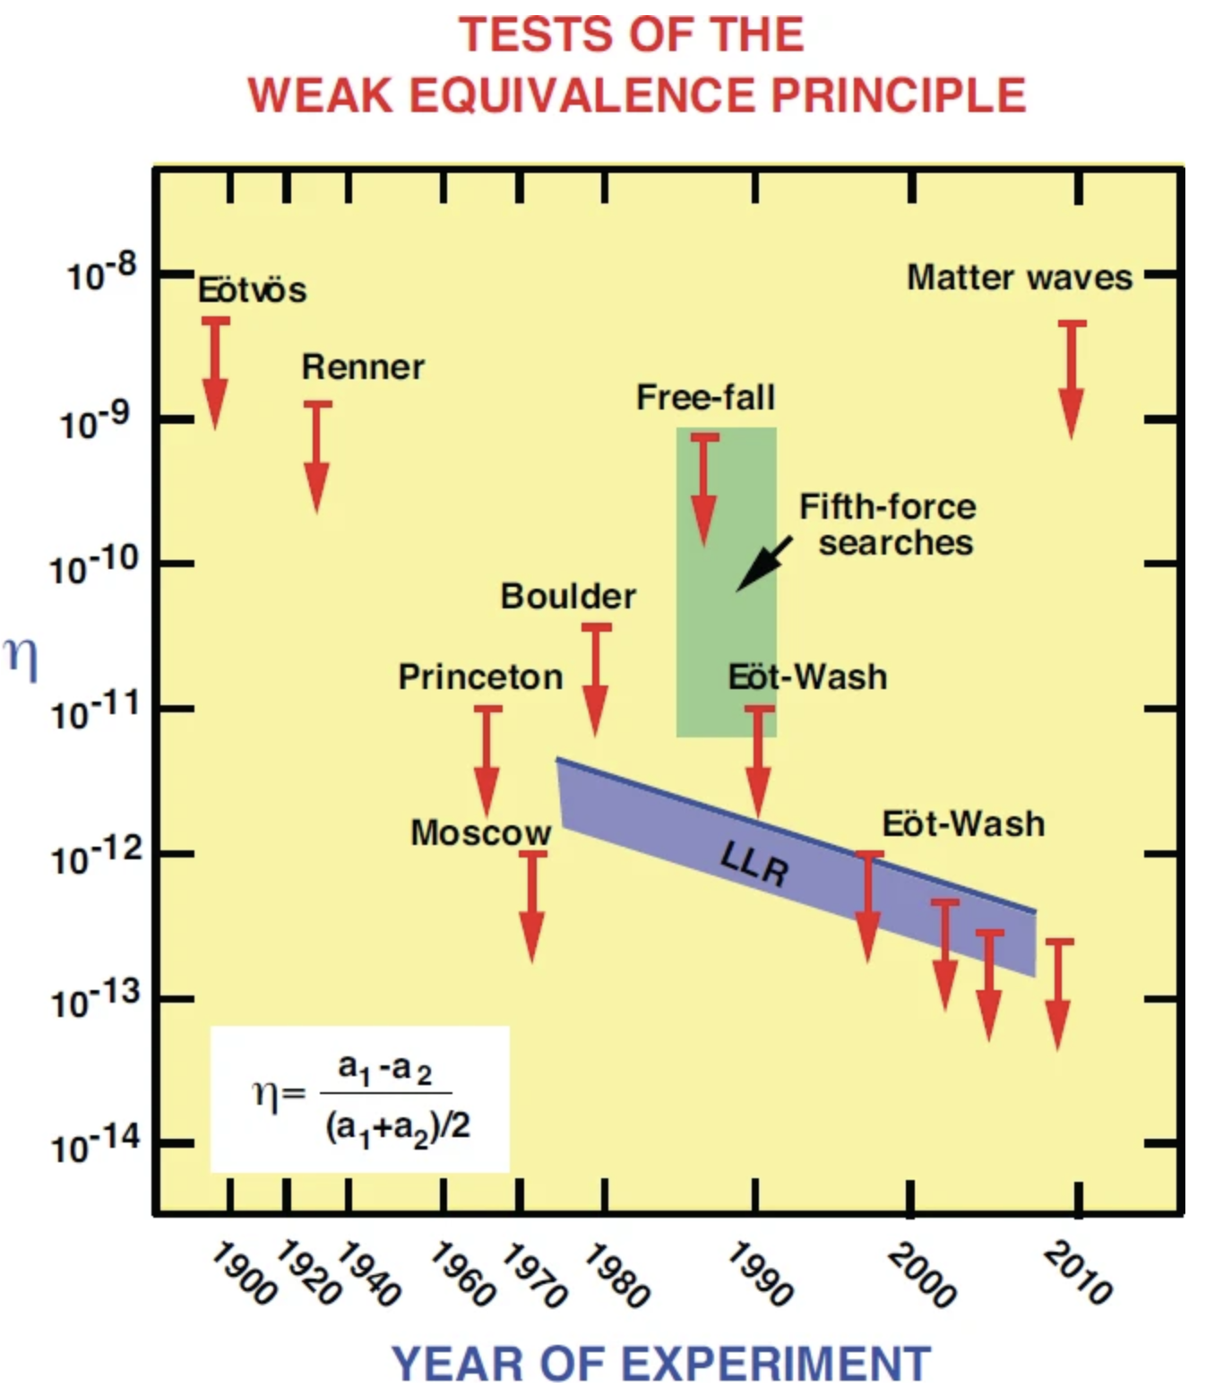
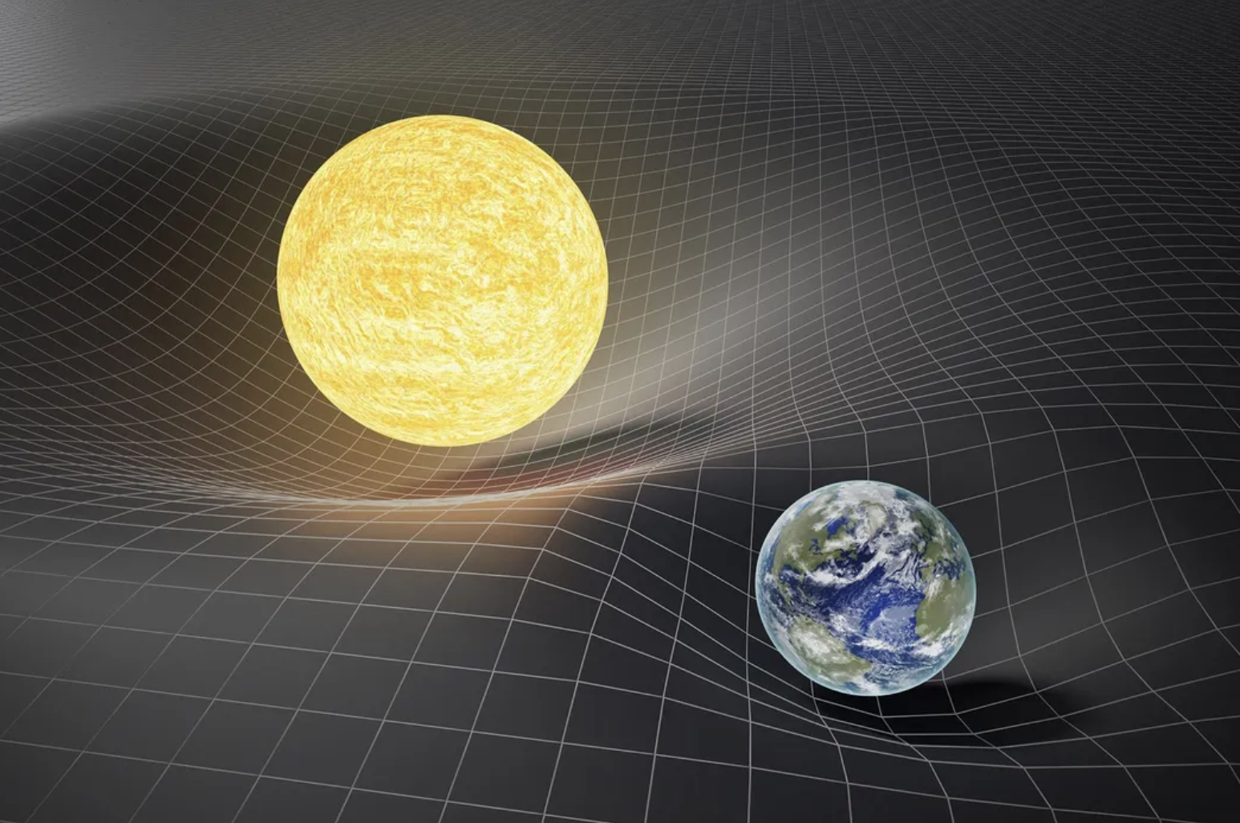
Tests of gravity on cosmological scales
The σ₈ tension
Will, 2006
DES Collaboration, OJA, 2023
Accelerated expansion
?
?
Agnès Ferté @ ML IAP/CCA – Nov 2023
3

Slide 4
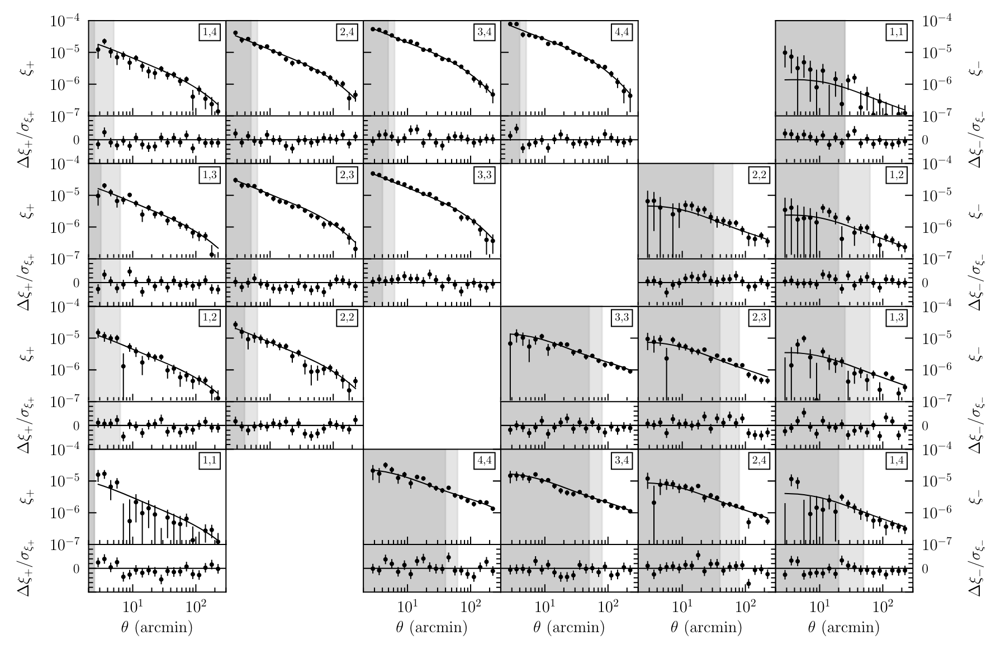

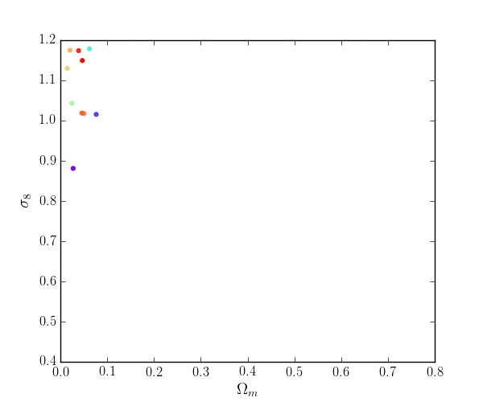
Current search of new physics with galaxy surveys
Precise measurements
of summary statistics
Parameter estimation:
likelihood sampling
DES Collaboration, PRD, 2022
By Carles Sánchez
Samplers comparison in
Lemos, Weaverdyck et al (incl. AF), MNRAS, 2023
=> Polychord validated for DES Y3 3x2pt sampling
Agnès Ferté @ ML IAP/CCA – Nov 2023
4

Slide 5
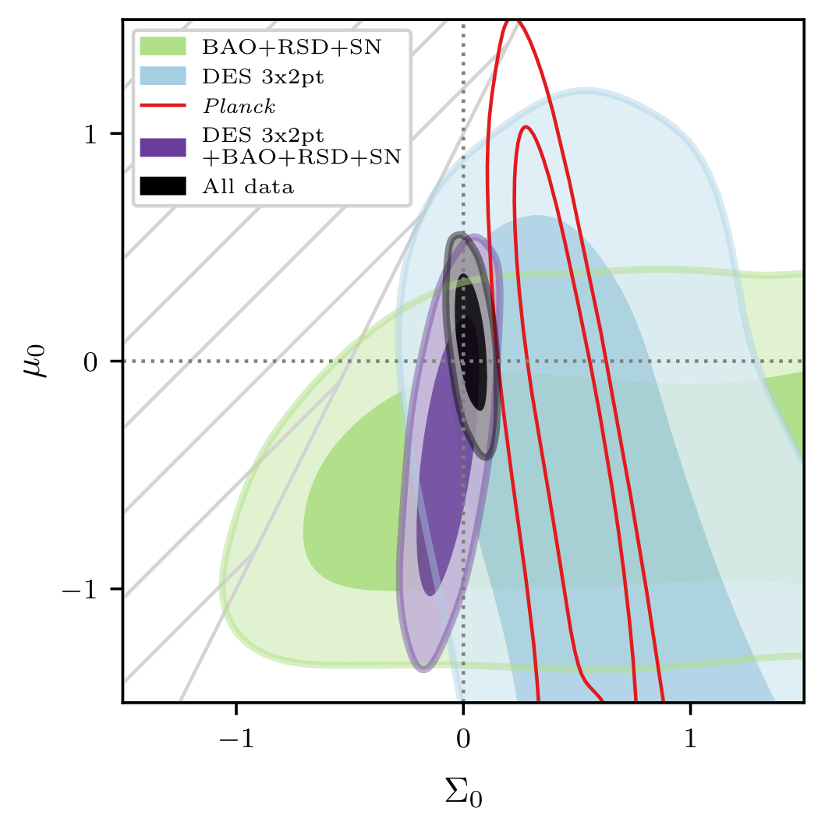
The case of beyond-ΛCDM models with DES Y3 weak lensing
DES collaboration, PRD, 2023
DES Y3 extensions (co-leads Jessie Muir and AF):
DES collaboration, PRD, 2023
Robust analysis of 7 models:
Blinded analysis:
  tests of systematics,
  scale cuts validation.
6 cosmological parameters + extended parameters
+ 22 nuisance parameters.
Run 700+ chains on HPC
Use of NERSC, TACC, GATTACA @ JPL, Sherlock @ Stanford.
Agnès Ferté @ ML IAP/CCA – Nov 2023
5

Slide 6
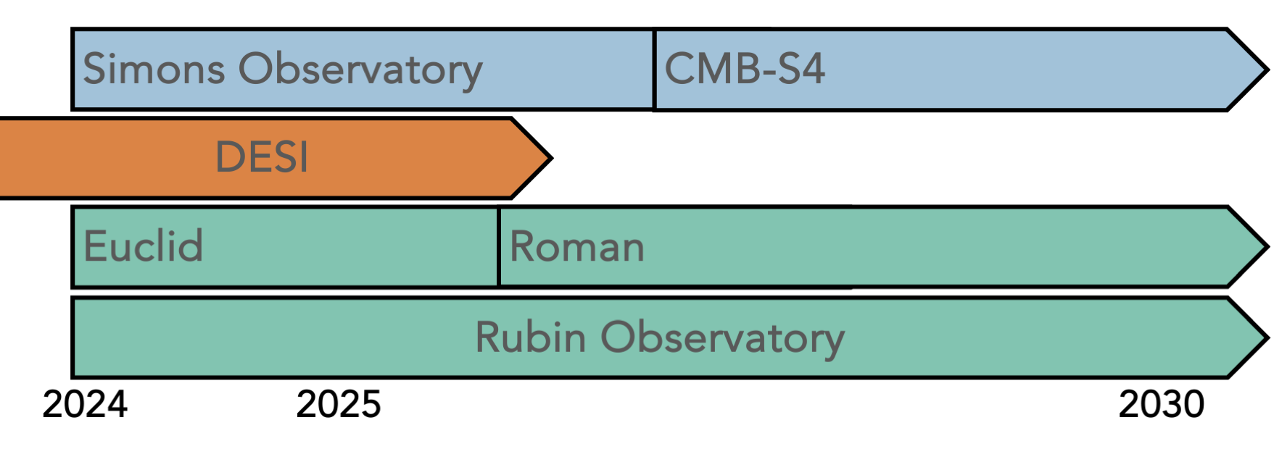
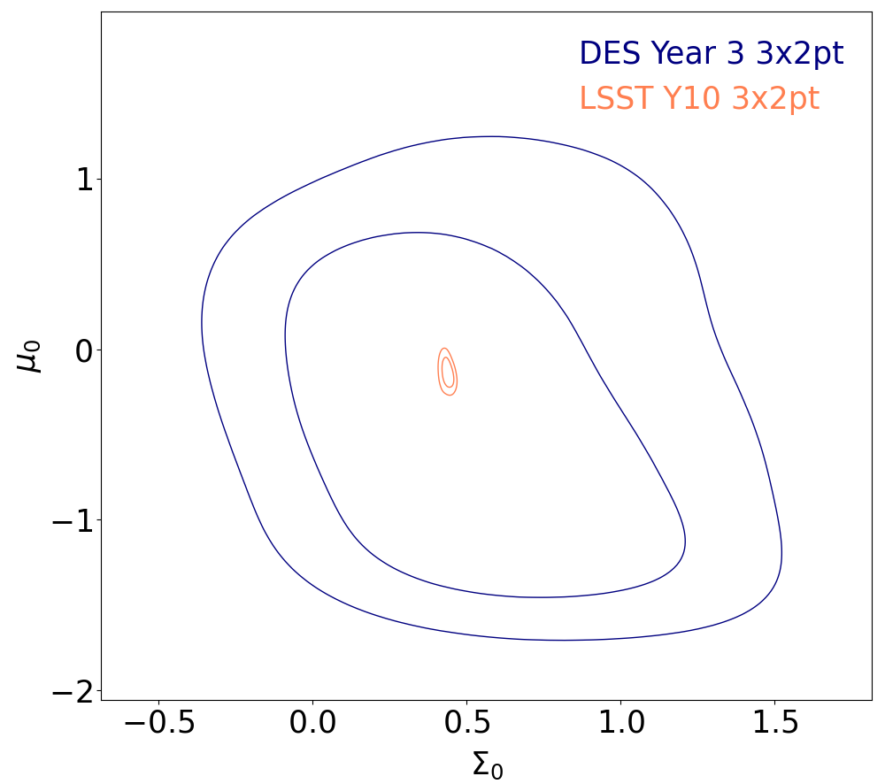
The Stage-IV experimental landscape
Updated from AF et al, PRD, 2019
Goals are:
Dark energy, modified gravity,
Cosmic inflation.
Baseline analyses will still rely on parameter estimation from precise measurements of summary statistics.
Agnès Ferté @ ML IAP/CCA – Nov 2023
6

Slide 7
Challenges and where Machine Learning can help
Challenges:
More complex parameter space,
Expensive likelihood evaluation.
➔ ML to enable faster analysis of measurements
to constrain new physics parameters
Improving the sampling in a large
parameter space
Emulators of summary statistics
CosmoPower
A. Spurio Mancini et al, MNRAS, 2022
Application to f(R): REACTEMU-FR
A. Spurio Mancini and Bose, OJA, 2023
Nautilus: inference using deep learning
J. Lange, 2023
Being used in DES Y6 (by Sujeong Lee) but need to retrain to adapt to our parameter space.
Great improvements for DES Y6 shear but polychord still performs better for 3x2pt.
Agnès Ferté @ ML IAP/CCA – Nov 2023
7
Notes:
TO DO:
Add citation

Slide 8
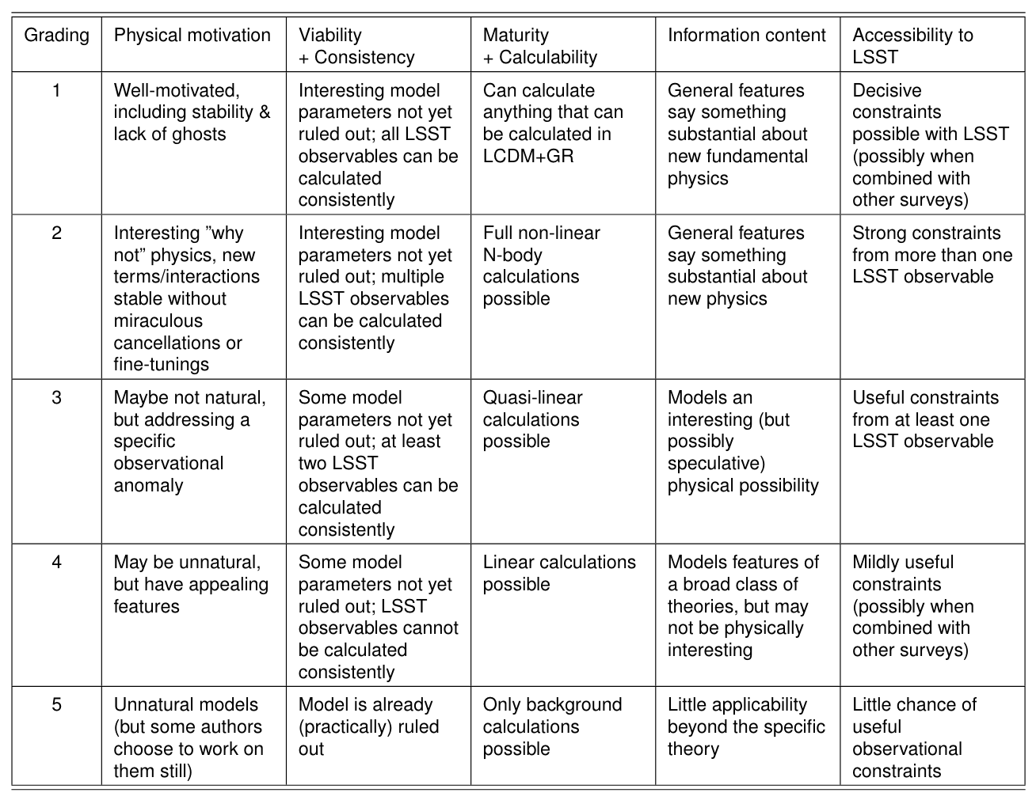
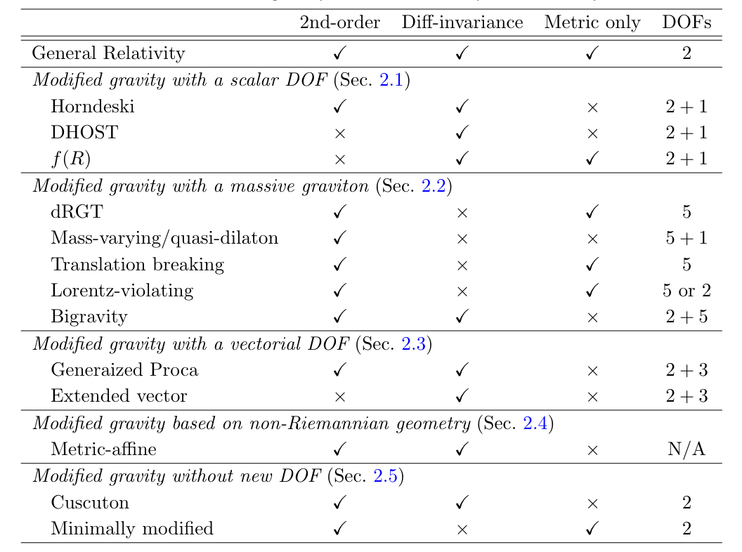
How to explore theory space with future surveys?
Ishak et al, 1905.09687, 2019
Updated from AF et al, PRD, 2019
Arai et al, 2212.09094, 2022
Theoretical perspective to decide which model to constrain
Phenomenological parametrization, EFT, …
Agnès Ferté @ ML IAP/CCA – Nov 2023
8

Slide 9
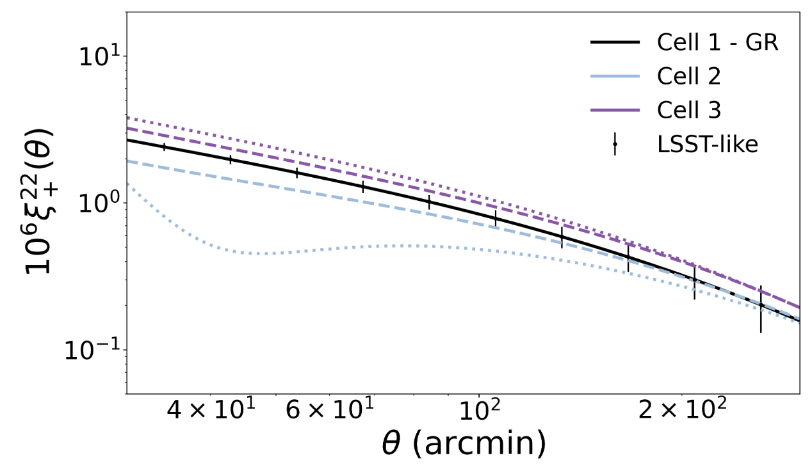
Gravity models impact probes differently:
How do models compare at the level of probes?
AF, Hemmati et al, OJA, 2023
Agnès Ferté @ ML IAP/CCA – Nov 2023
9

Slide 10
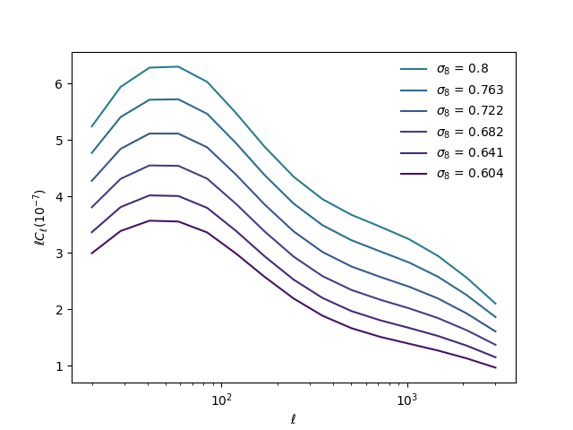
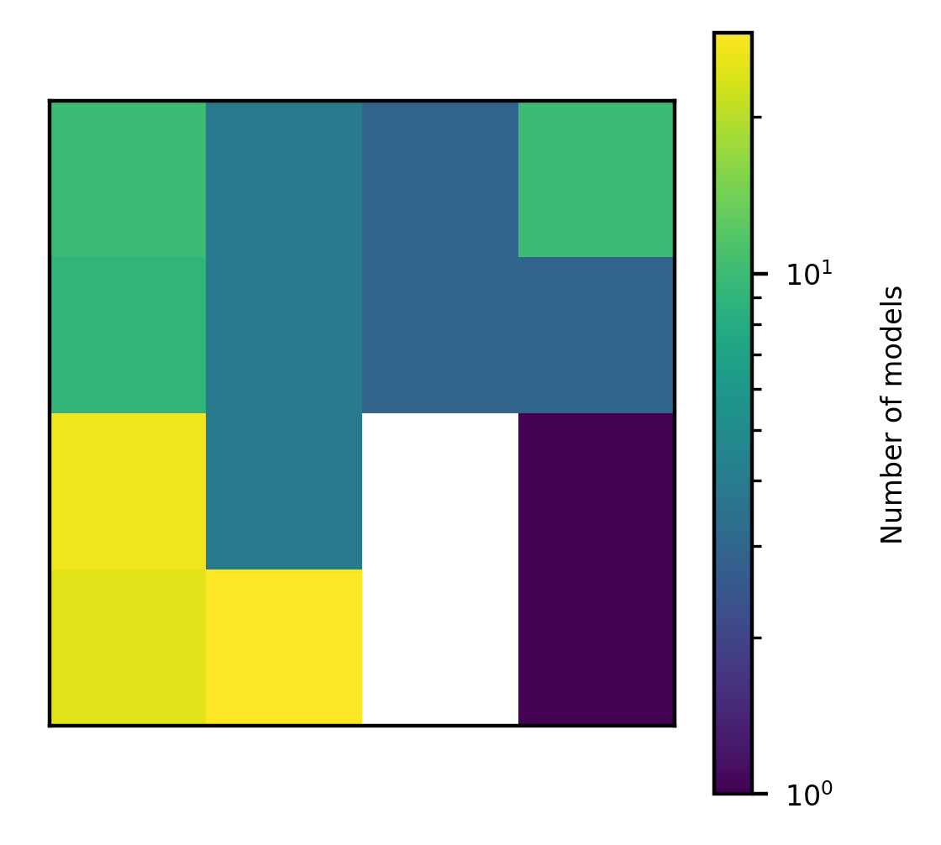
Map MG models onto 2D map using Self-Organizing Map
1. Producing the training set
Cosmology: fixed parameters
+
Modified gravity: varying parameters
+
Vary s₈
Theoretical predictions of cosmic shear
5 redshift bins
15 values of multipole ell
=> 225 elements per data set
MGCamb + CosmoSIS
2. Training the SOM
6x6 SOM grid
SOMPY
Approach proposed in AF, Hemmati et al, OJA, 2023
Other approach proposed in Mancarella et al, PRD, 2022 using BNN
Agnès Ferté @ ML IAP/CCA – Nov 2023
10

Slide 11
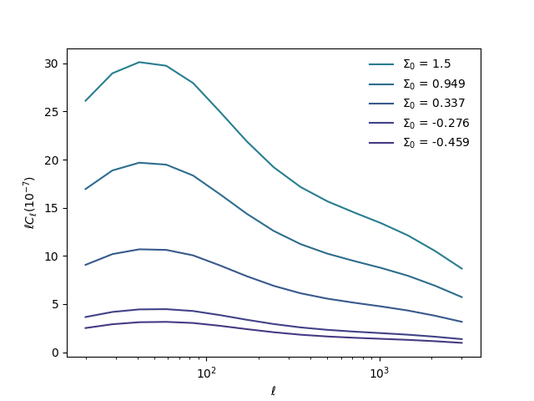
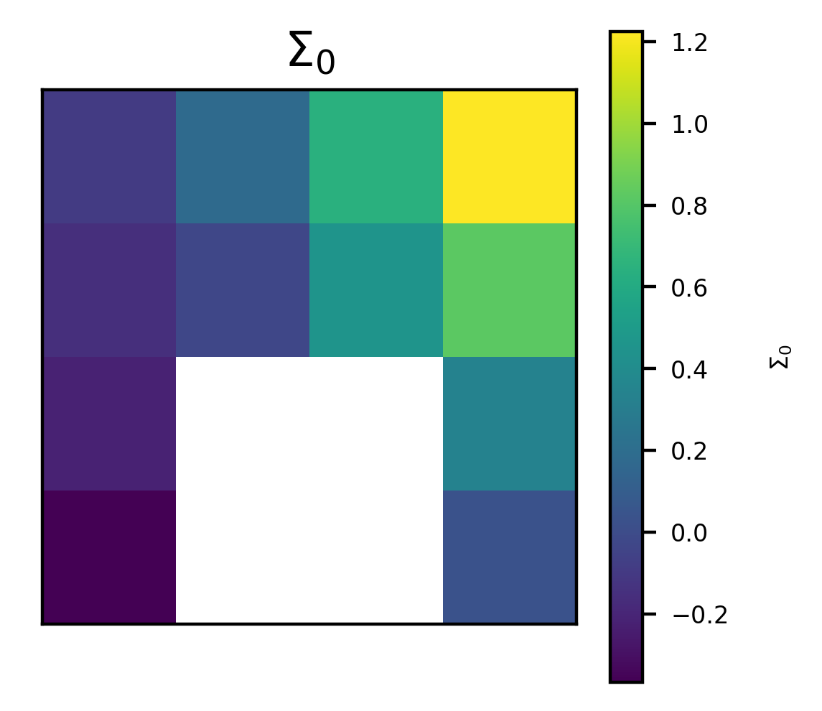
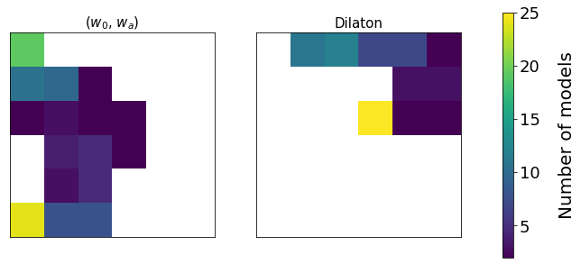
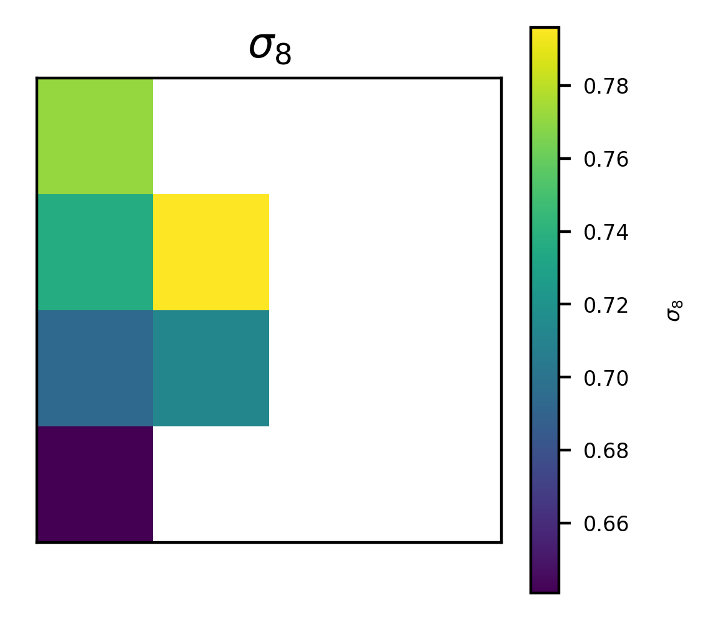
Understanding MG models impact on cosmic shear with SOM
Dark energy and modified gravity should both be tested,
Dilaton has a unique signature,
Application to σ₈ tension.
From AF, Hemmati et al, OJA, 2023
Agnès Ferté @ ML IAP/CCA – Nov 2023
11

Slide 12
Outlooks to enable detection of new physics with future surveys using ML
ML to accelerate analysis and decide on theories to explore.
Deep learning cosmology.
DESLearning: Co-PIs Tomasz Kacprzak and AF,
for NERSC-NESAP to accelerate the training on GPUs.
For MG, analysis using summary statistics and deep learning:
need modeling developments.
Agnès Ferté @ ML IAP/CCA – Nov 2023
12

