Slide 1
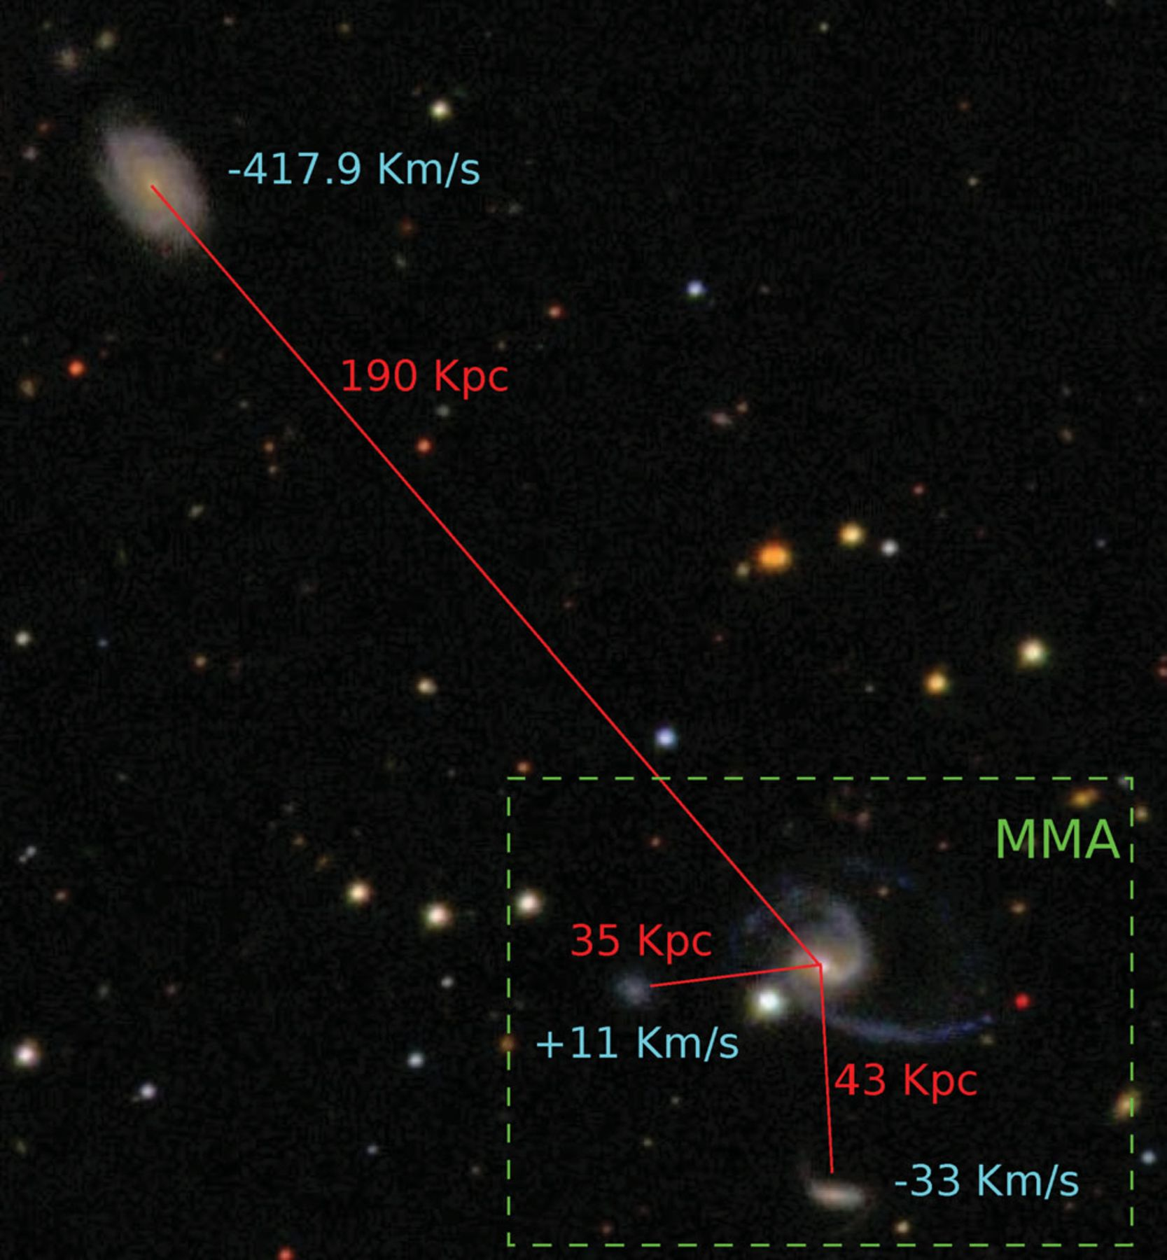
Finding Observable Environmental Measures of Halo Properties Using Neural Networks
Haley Bowden
Collaborators: Peter Behroozi, Andrew Hearin
ML-IAP/CCA-2023
Robotham et al. 2012

Slide 2
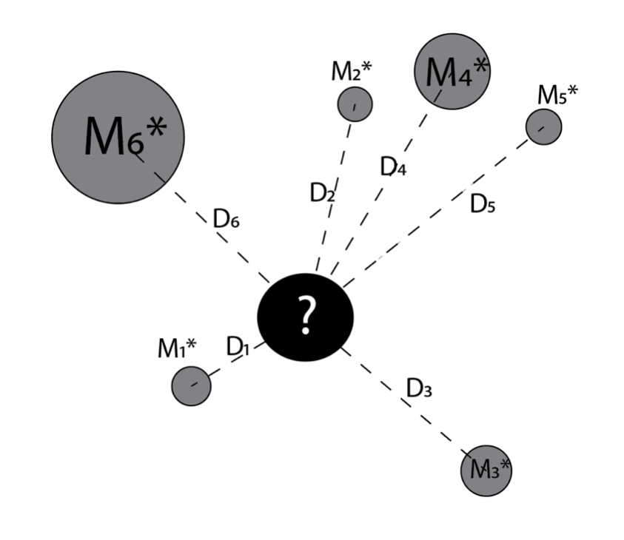
$$X_{halo}=f(M_{∗},Environment)$$
Consider what information about the environment is available
Train a neural network to serve as a function from our input vector to our desired output
Input Vector
$$X_{halo}$$
Condense that information into an input vector

Slide 3
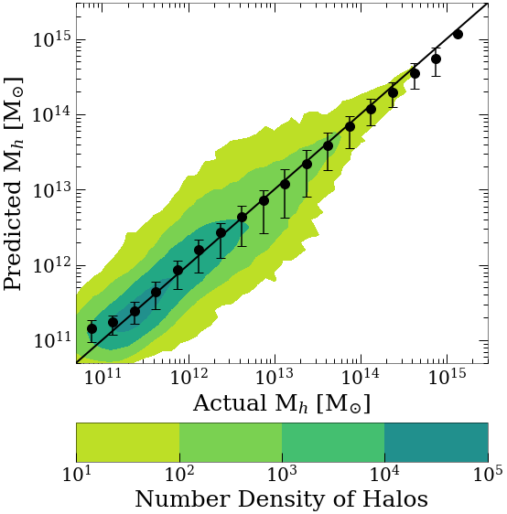
High accuracy from stellar mass alone
High accuracy from environmental information
Comparing ML predictions to “true” values from the simulation
*Check out: Bowden, Behroozi & Hearin 2023 (arxiv:2307.07549)

Slide 4
Halo Concentration (PRELIMINARY)
But what happens when we expand to secondary halo properties?
Lower accuracy (but there is information there!)

Slide 5
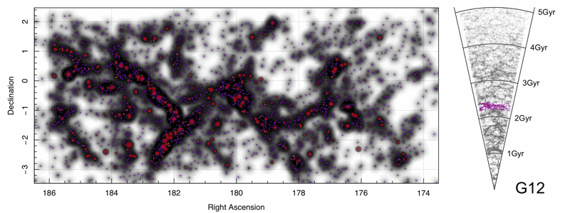
Conclusions: A neural network allows us to capture information about the galactic environment as it pertains to halo mass and concentration. A halo catalog for the GAMA Survey is in the works!
Density of galaxies in a redshift slice for one survey region
??

